Slide 1
Introduction to Trail Maintenance
Instructor
Date
Notes:
Welcome to Introduction to Trail Maintenance
Introduce instructors
Ask participants to introduce themselves

Slide 2
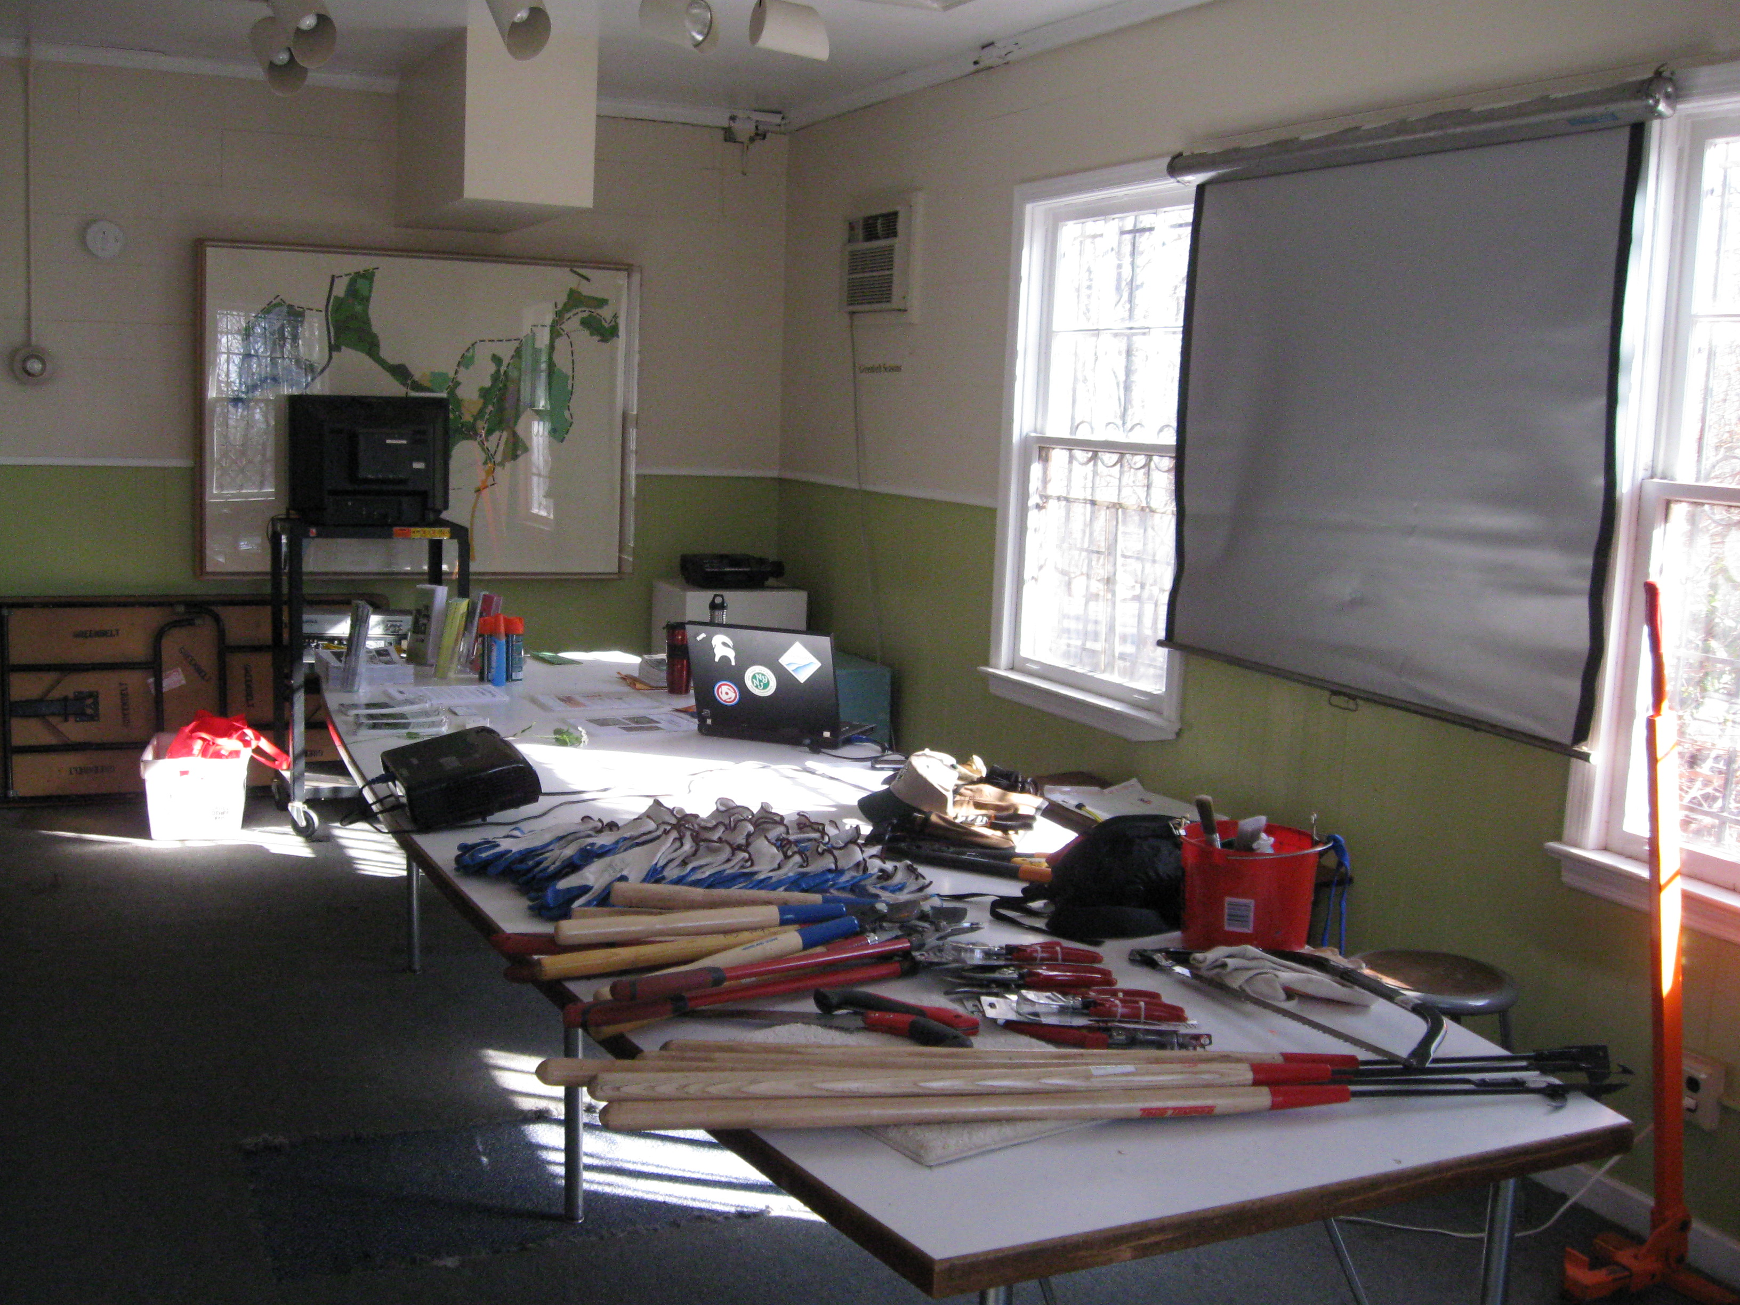
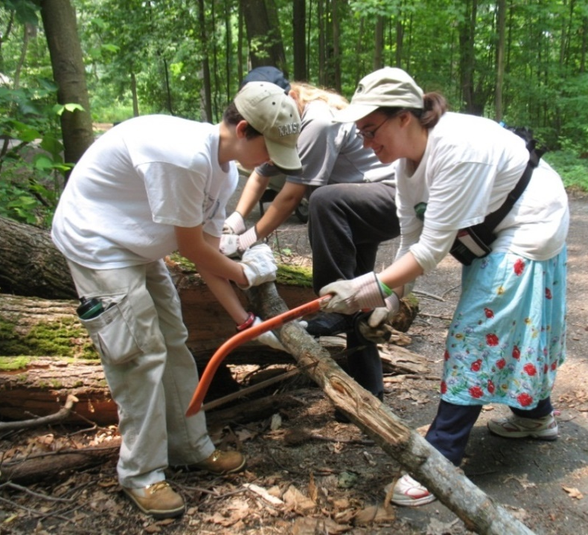
Agenda
Classroom presentation
Welcome and introductions
Classroom instruction
Lunch
Hands-on field work outside
Field work

Slide 3
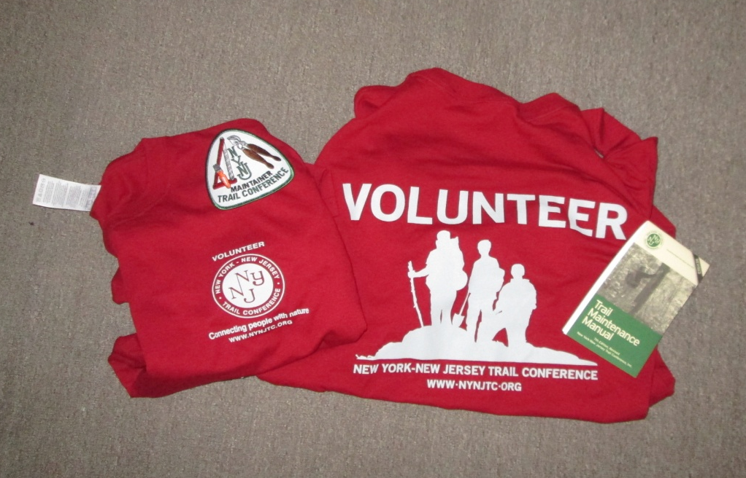
Maintainers are VIPs!
The Trail Conference has over 1000 maintainers
Caretakers of our trails
Public face of the Trail Conference
Educators to the public
Notes:
Maintainers must be members of the Trail Conference or a member of a maintaining club
Public face/ambassadors when you meet the hiking public—you will get a T shirt to wear
TC members get a 10% discount at many outdoor stores

Slide 4
Trail Conference Organization
Board of Directors
Policy Council
Executive Director
Staff
West Hudson RTC
New Jersey
RTC
Catskills RTC
RPC
RPC
RPC
Policy Council Rep
RTC Chair
Regional Program Coordinator
(staff)
Program Committees
Local
Trail
Committee
(LTC) Chair
Conservation
Program Committee Reps
Publications
Other LTCs
Sawyers
Technology
Trail Supervisors,
Crew Chiefs, Long
Distance Trail Reps
Volunteer
Maintainers, Monitors,
Crew members
East Hudson
Regional Trails Council (RTC)
Notes:
Maintainers report to supervisors, who report to LTC chair. There are 4 RTCs, which include the LTCs within the region.

Slide 5
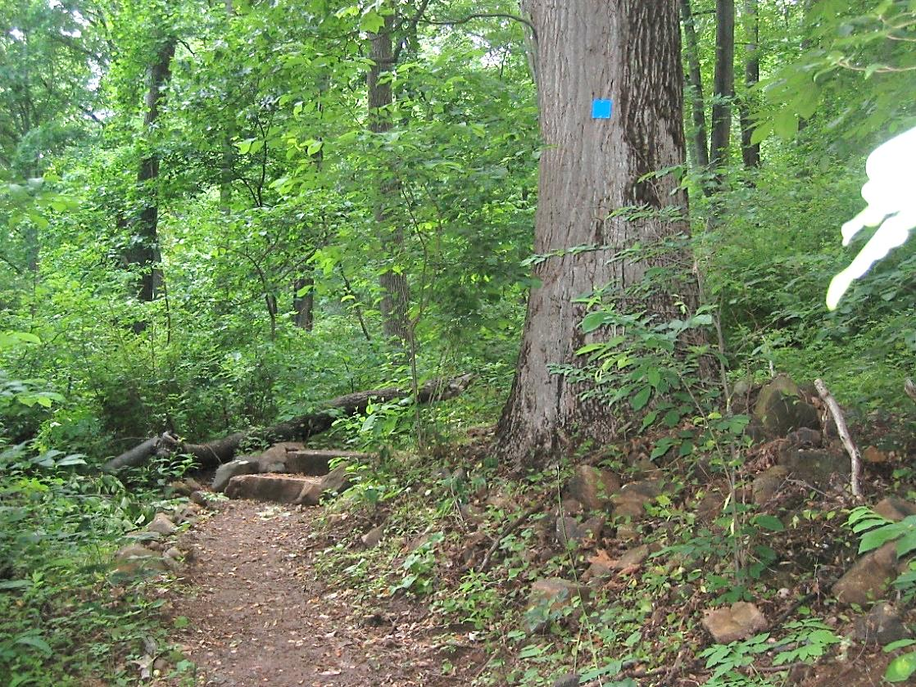
Trail Terminology
Trail Marking (blaze)
Trail Corridor
Trail Structures
Trail Tread
Notes:
Let’s get started with some terminology.
When we refer to a ”trail” we often are referring to one or more of these components. Terminology is important because the trail is a sum of these parts. For example, when people refer to trail erosion, they are not referring to the corridor eroding, but to the actual earthen tread.

Slide 6
What Does a Trail Maintainer Do?
Notes:
Ask participants to list activities a maintainer might need to do; list them on a whiteboard or flip chart if possible.
Using the list the participants came up with, ask which items they feel pertain to safety of hikers using the trail or themselves as a maintainer
Circle the items or mark them with a color.
You will refer and add to this list throughout the class.

Slide 7
What Does a Trail Maintainer Do?
Inspects trail to determine condition and work required
Clears vegetation to keep the trail open
Maintains blazing
Removes litter, fire rings, graffiti, etc.
Reports problems requiring assistance
Bridges, steps, water bars, etc. needing repair
Large blowdowns needing a chain saw
Makes trail improvements (often with help from others)
Erosion control, improving wet areas
Files reports on work done
Notes:
Here is a list of some major activities
Did the group miss anything?

Slide 8
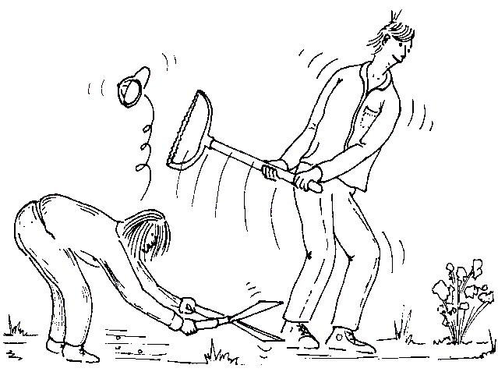
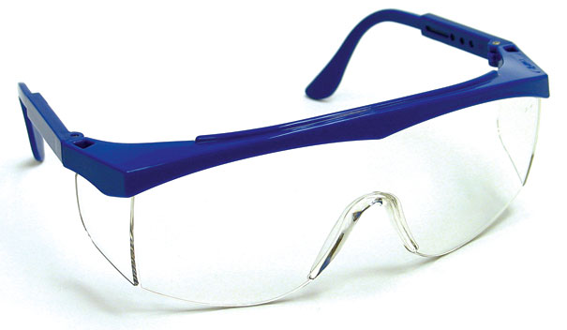
Safety
Eye protection should be worn for all maintenance work
Eyeglasses are acceptable
Notes:
Before talking about trail maintenance activities, emphasize that we always need to think about safety.
At the beginning of this section, ask if any have had accidents on the trail. Inquire as to how the accident could have been prevented.
Refer to Trail Conference Safety Guidelines; note that all maintainers should wear safety glasses.

Slide 9
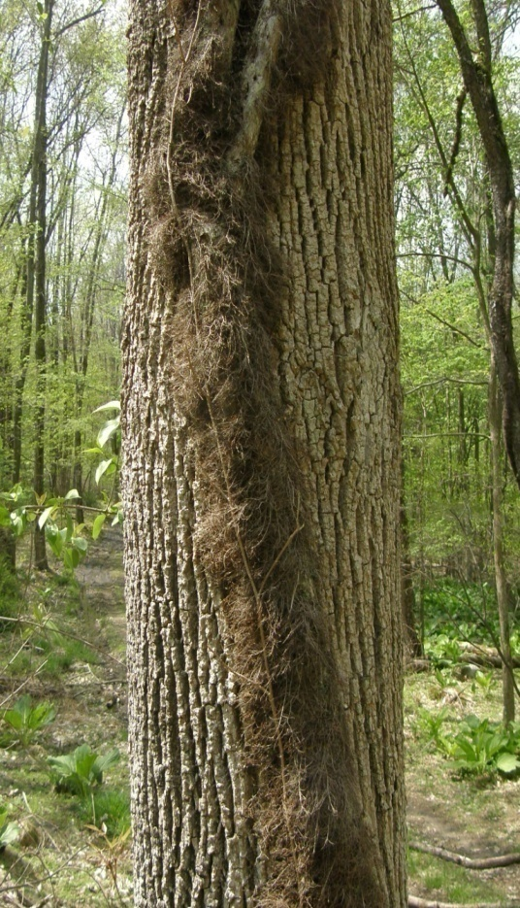
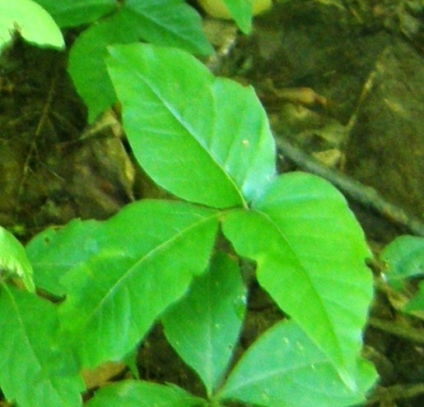
Watch Out for These!
Ticks
Poison Ivy
Stinging Insects
Venomous Snakes
Notes:
Be aware of usual hiking hazards:
Use great care in clearing poison ivy: Leaves of three, let it be. The hairy vine is also toxic.
Ticks, yellowjackets, snakes
Heat, cold, lack of water, becoming lost, …

Slide 10
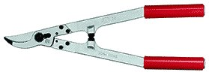
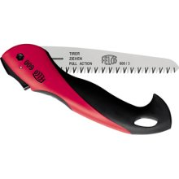
Common Tools for Trail Maintenance
Blazing supplies and equipment
Litter bags
Sturdy work gloves
Loppers
Hand pruners
Aggressive pruning saw (fixed blade or folding with at least a 12-inch blade) or bow saw
Some maintainers use a weed whip or hedge trimmers for low-growing plants
Notes:
Bring a good collection of tools to the class. Allow people to look at them during the class break. Some attendees may never have seen some of the tools used.
Remember to sharpen the pruners or loppers if dull.
Razor-tooth pruning saws, either fixed or folding, cut better than bowsaws. Prefer at least a 12 inch blade, but larger sizes can be expensive. If you use a bow saw, 24 inch blade is best.

Slide 11
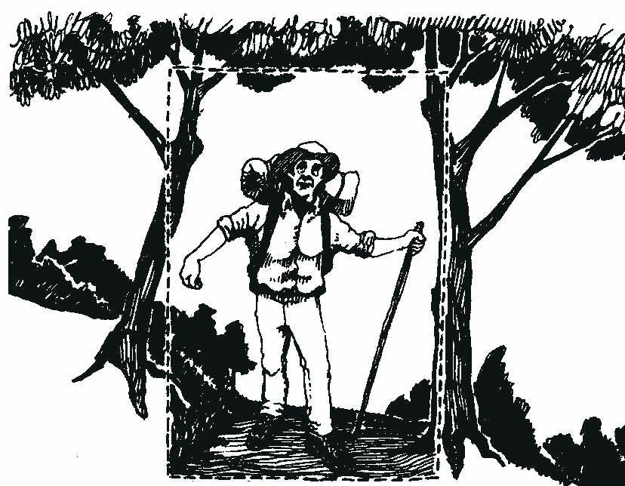
Clearing the Corridor
Before
Appalachian Trail Specification
8 feet high
After
4 feet wide
Trails with little backpacking traffic may be narrower with less overhead clearance
Be sensitive to the environment—don’t clear excessively
Notes:
Brushing against vegetation is not something hikers like – especially barberry

Slide 12
Cutting Branches
Notes:
Cut where a branch come out from a larger branch. We will practice in the outdoor session

Slide 13
How Far Back to Trim
Correct!
Cut back to a major branch; don’t just cut off twigs
Wrong!
Sharp branches stick out and new growth will quickly block the trail
3-4 feet
3-4 feet
7-8 feet
7-8 feet
Rapid growth here
Cut here
Tread
Tread
Notes:
Many new maintainers trim just to the edge of the trail corridor. Cutting back to where the branch comes out of a larger branch or at the ground, even if it is somewhat off the trail, increases the time before you need to trim again. It also eliminates sharp branches which could hit someone in the face. Some judgement is needed so the trail does not become too wide overall.

Slide 14
Removing Small Blowdowns
Notes:
Can cut blowdowns up to about 6 inch diameter with a 24-inch bowsaw, but depends on physical ability of maintainer.

Slide 15
Blowdowns Too Large for You to Cut
Notify your supervisor:
Location (notable landmark or distance)
Size (diameter)
Other notable features such as multiple trees or dangerous conditions
Take a photo if you can
Notes:
Sawyer will be annoyed if he or she carries in a heavy saw and can’t find the blowdown or finds that it is the size of a toothpick.
Can measure with a dollar bill, which is about 6 inches long.

Slide 16
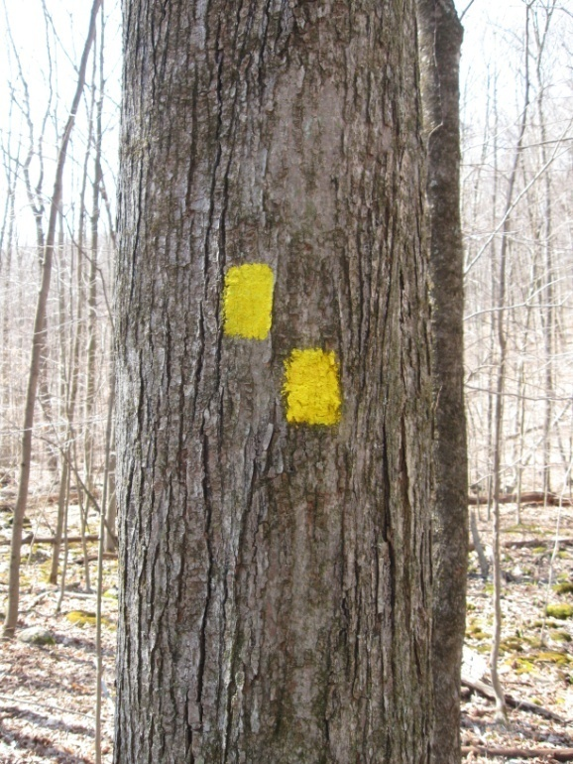
Marking the Trail
Paint Blaze Tag Blaze
Notes:
Type and color of blaze is a land manager decision
Supervisor will let you what to use on your trail

Slide 17
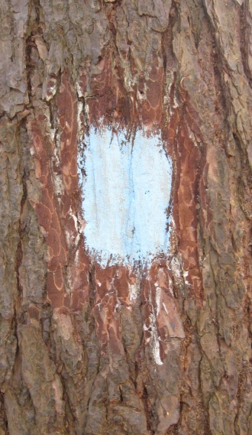
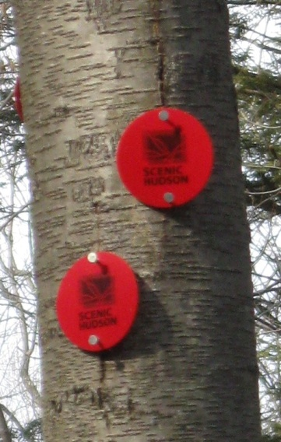
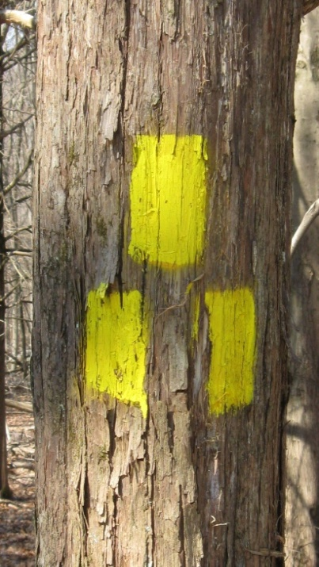
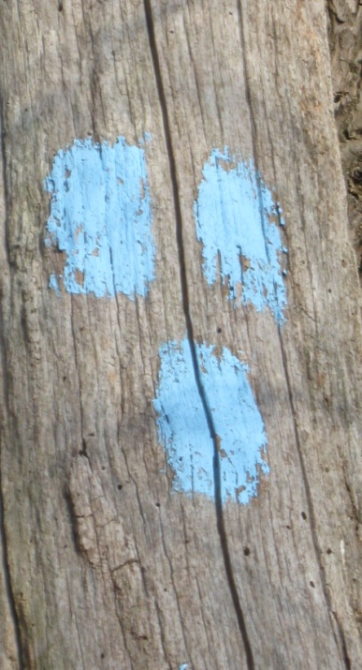
Blaze Patterns
Standard
Blaze
Right Turn
(upper blaze shows direction of turn)
Start of Trail
End of Trail
Notes:
Blaze Patterns. Importance of standard colors and markings. Lets try blazing.
Tips to remember start and finish blaze:
A-shape like an arrow down the trail
V-shape for victory – reached the end of the trail

Slide 18
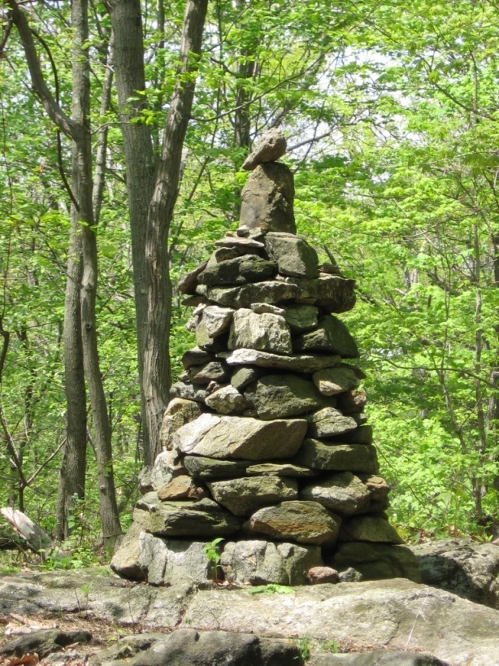
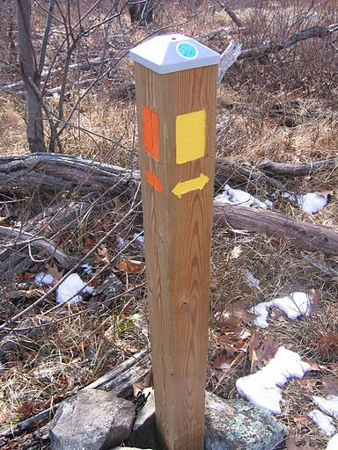
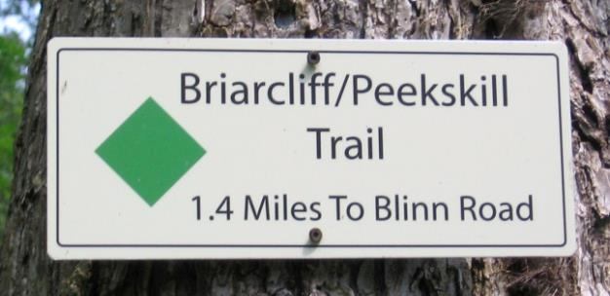
Other Trail Markings
Posts
Signs
Cairns
Notes:
Cairns are a trail structure and must be built according to a standard appropriate to be structurally sound. Refer to a crew chief or resources at the TC office for further information on building cairns.
Signs and posts come in many styles with a variety of different information. The land manager must approve signs and posts prior to installation.

Slide 19
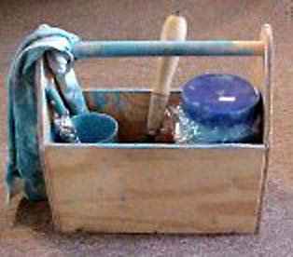
Paint Blazing Tools
Scraper
Brush – 1 to 1.5 inch wide with cup and plastic wrap
Paint in screw top jar
Equalizing spray paint (gray and brown)
Rags, disposable gloves
Plastic bag(s)
Template
2x3 inch, except 2x4 for Long Path and 2x6 for AT
Do not paint through the template; use it to gauge proper size
Notes:
Supervisor will tell you what color—see TC web site for standard paint colors
Scrape trees with rough bark to have a smooth painting surface; never scrape through the bark to the cambium layer.
Use a template to get accurate blaze size and shape: 2x3 inch, except 2x4 for Long Path and 2x6 for AT
Use a small brush for painting
Avoid blazing if rainy or temperature is below 50 degrees

Slide 20
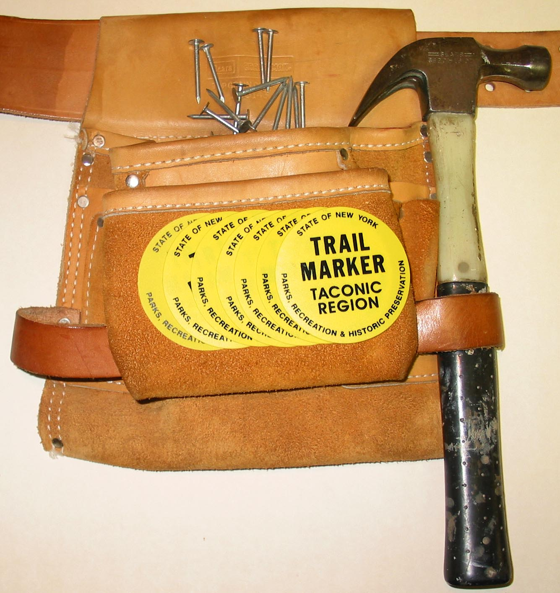
Tag Blazing Tools
Hammer
Nails
Tags
Pouch

Slide 21
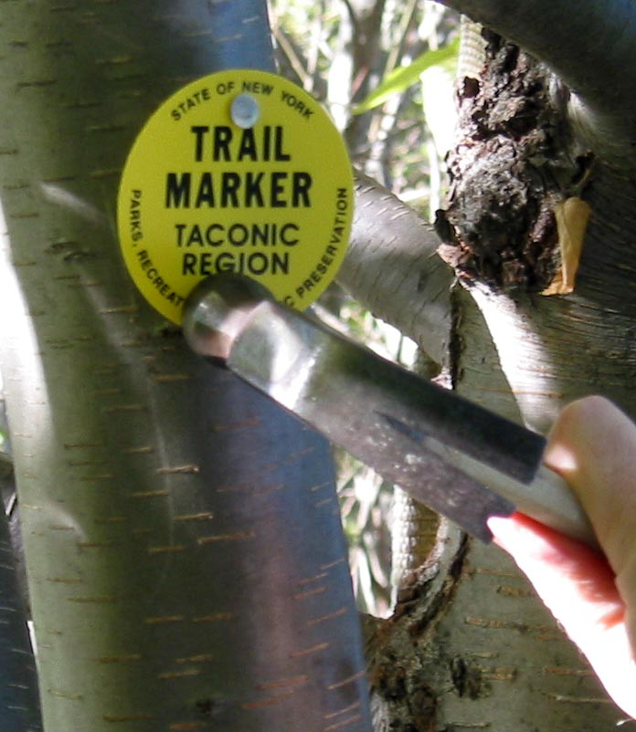
Tag Blazing
1 inch
Nail
Tree
Blaze
Nail
Use 2-inch galvanized roofing nails
Allow 1 inch space for the tree to grow
Nail at top and bottom—never at sides
A few trails use one nail
Critical
Notes:
Use 2 inch galvanized roofing nails unless a park wants aluminum nails
Do not nail tight against tree--allow about 1 inch for growth
Use 2 nails, one near top and one near bottom, never at sides; your supervisor will tell you if trail uses only 1 nail

Slide 22
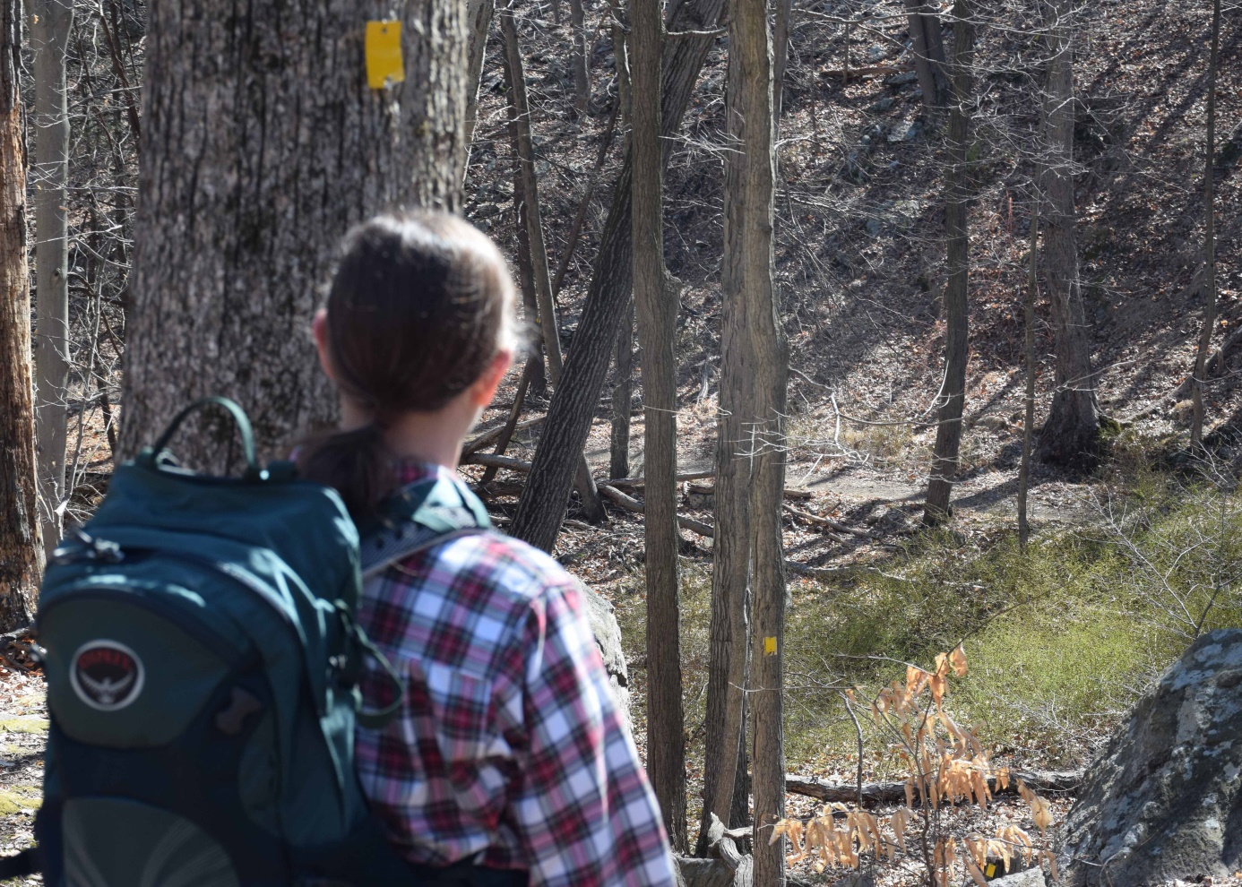
Successful Blazing Trips
Make a separate blazing trip, preferably with two people
Blaze one direction, then the other direction
Don't just repaint blazes; take a fresh, objective look
Notes:
This picture shows the importance of standing by one blaze to determine where the next blaze should be.
Ask why it is important to blaze in one direction and then blaze on return.

Slide 23
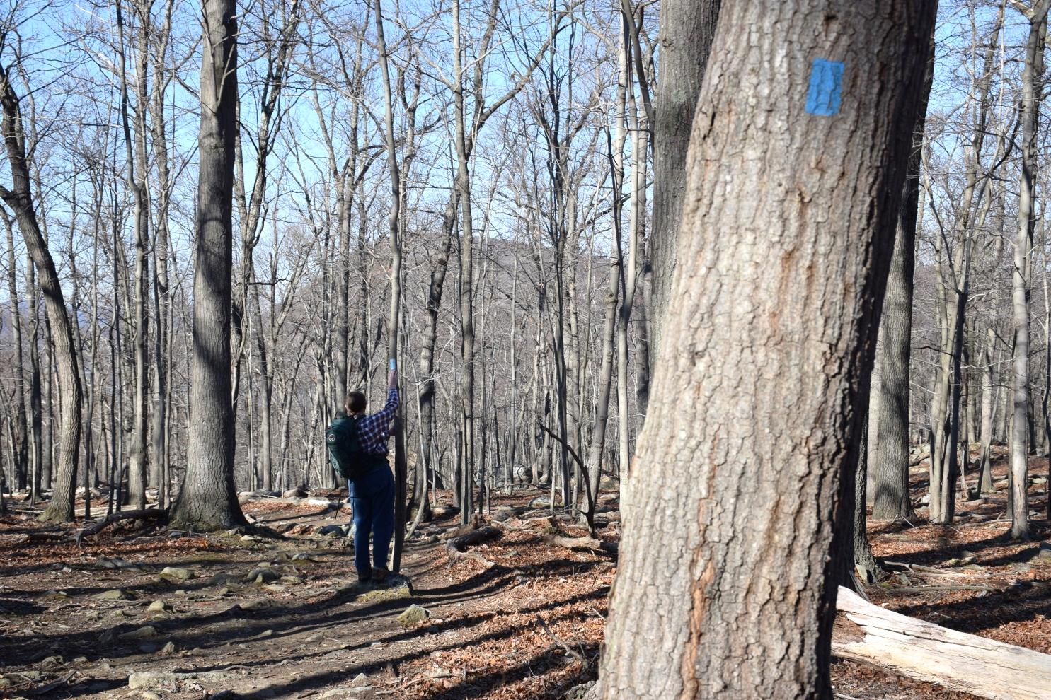
Underblazing or Overblazing
Rule of thumb: When passing a blaze, next blaze should be visible
Fewer blazes on woods roads, more in open areas
Trailheads and trail crossings must be marked clearly
Notes:
This is an open area, which requires more frequent blazing.
Some parks now want more frequent blazing due to larger number of inexperienced hikers.

Slide 24
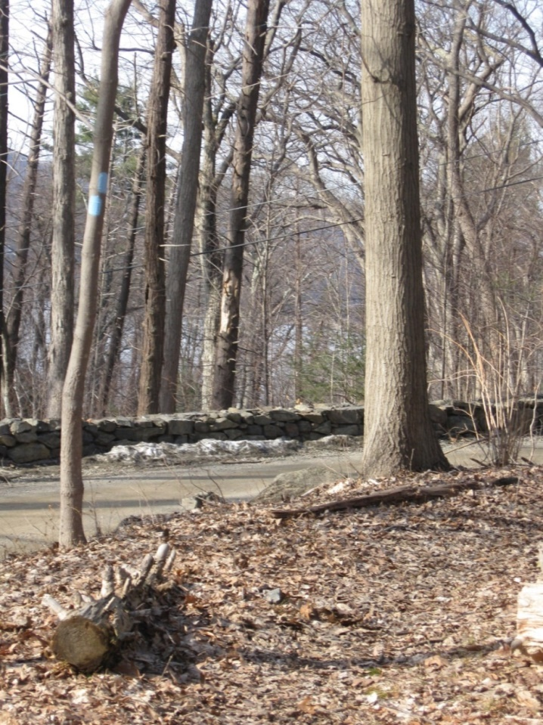
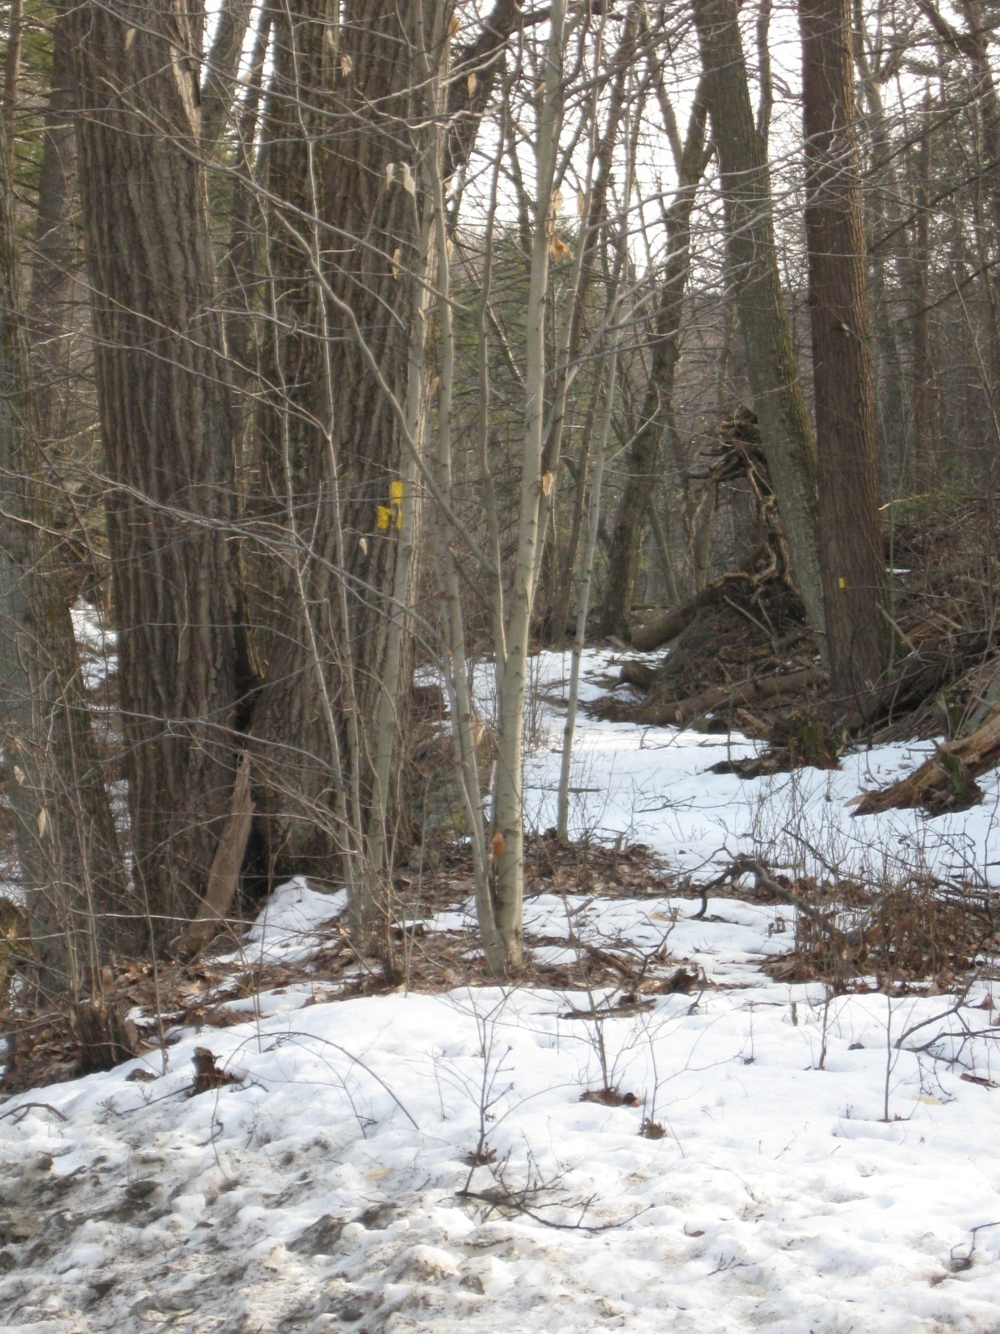
What to Blaze
Blaze trees which catch the eye, preferably large trees near the trail with dark-colored bark
Blazes should be near eye level
Clear brush so blazes are visible
Notes:
Left: Blaze a large tree rather than a small one
Right: Vegetation has not been completely removed

Slide 25
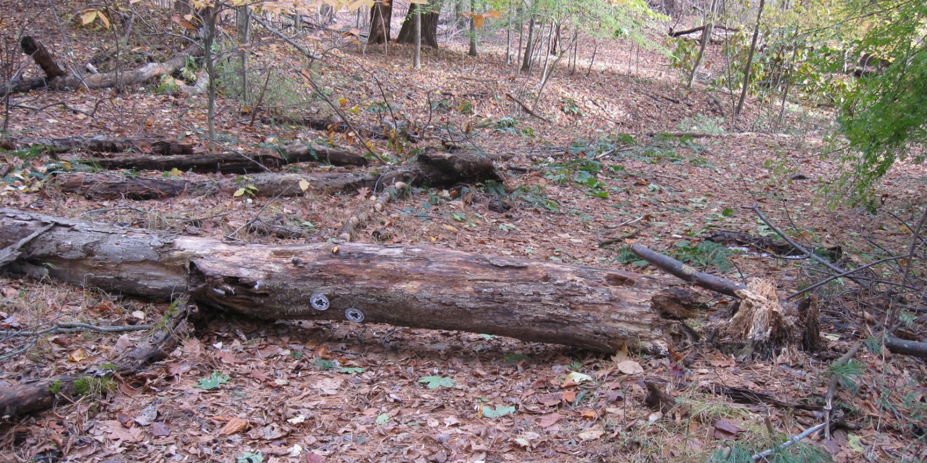
Blazing Hints
Never blaze dead trees
Avoid blazing rocks if there are trees to blaze
Paint out unneeded blazes with gray or brown spray paint
Notes:
Picture shows dead tree with blazes
Ask why it is better to avoid painting rocks. What if they are covered with snow? Also removing blazes painted on rocks looks ugly.

Slide 26
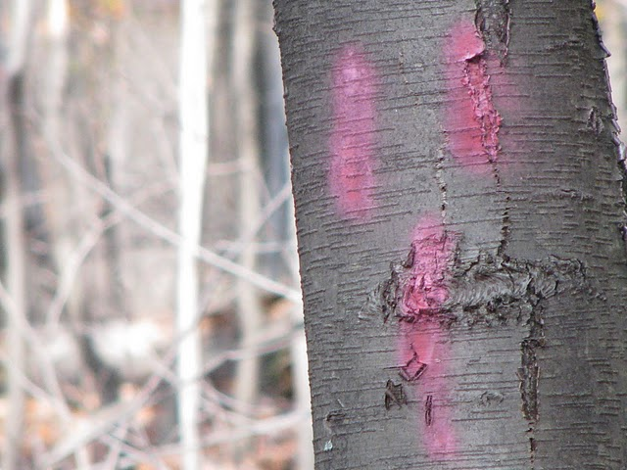
Can You Spot the Problems?
Notes:
Left: Sloppy, faded, and old paint blazes.
Right: Blazes hammered in too far (leave about 1 inch of nail protruding when you nail up blazes).

Slide 27
Blazing Turns
If nothing to blaze before the turn, place turn blaze here
Put confirmation blaze a short distance past the turn
Place turn blaze before the turn if possible
Place turn blazes at turns of 45 degrees or more
Trail
Notes:
Be careful that the blaze after the turn is not visible before the turn.
In an open understory or other area where the line of site is clear, hikers will be tempted to cut the corner when later blazes are obvious.

Slide 28
Blazing Two Trails on the Same Treadway
Place blazes for both trails on the same trees, one above the other in the same order
Blazes for long-distance trails such as the AT should be above blazes for local trails
Appalachian Trail blaze
Local trail blaze
Trail

Slide 29
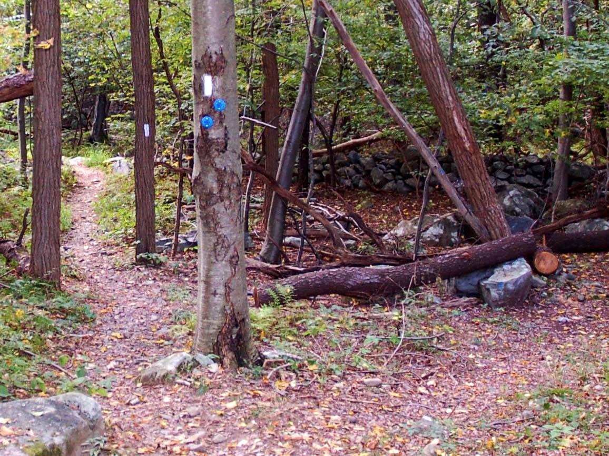
Example of Co-aligned Trails
Notes:
Appalachian Trail and blue trail are co-aligned to this point, where blue trail turns right and AT goes straight

Slide 30
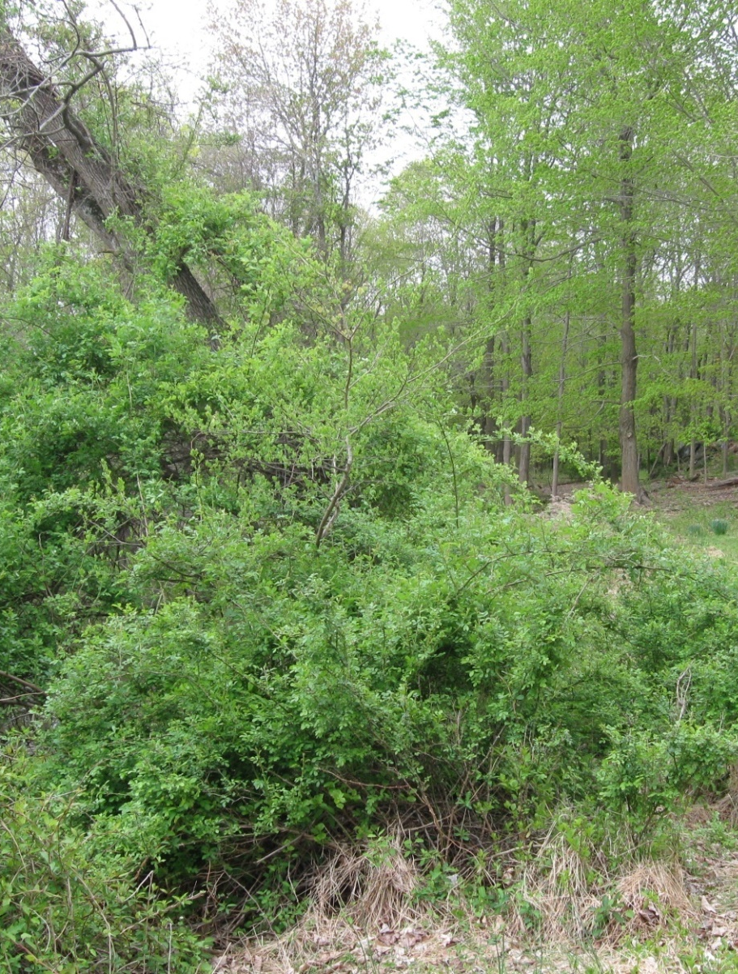
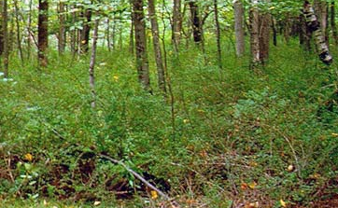
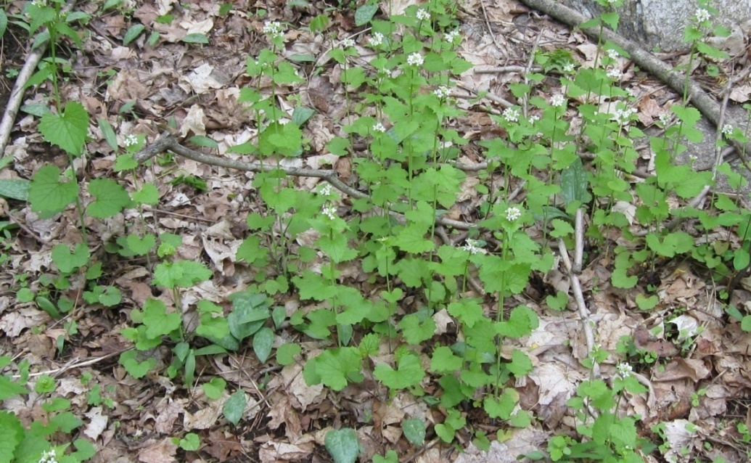
Special (and Not So Special) Plants on Your Trail
Multi Flora Rose
Barberry
Garlic Mustard
.
Notes:
On your first trip, you will see what invasives are on your trail.
Maintainers need not be plant experts, but it’s interesting to know something about plants which grow near your trail.
If your trail has threatened and endangered species along it, your supervisor will tell you.

Slide 31
Trail Conference Invasives Strike Force
www.nynjtc.org/invasives
Notes:
Relatively new initiative; looking for volunteers.
A new class will be available to teach maintainers what they can do about invasives on their trail.

Slide 32
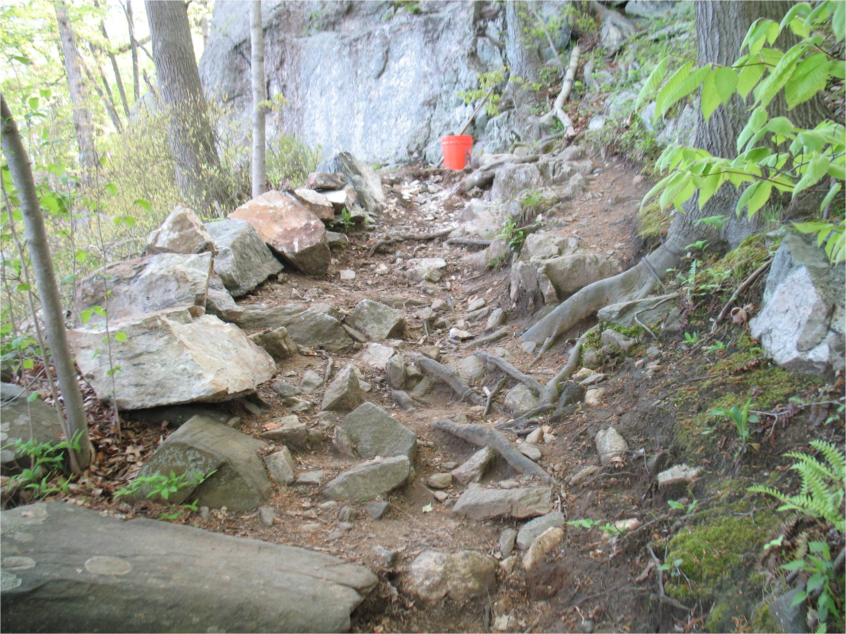
Trail Evaluation
Notes:
Be aware of poor trail conditions. If you don’t like it, neither will others.
What options are there here?
The following charts discuss problems which your evaluation might find.

Slide 33
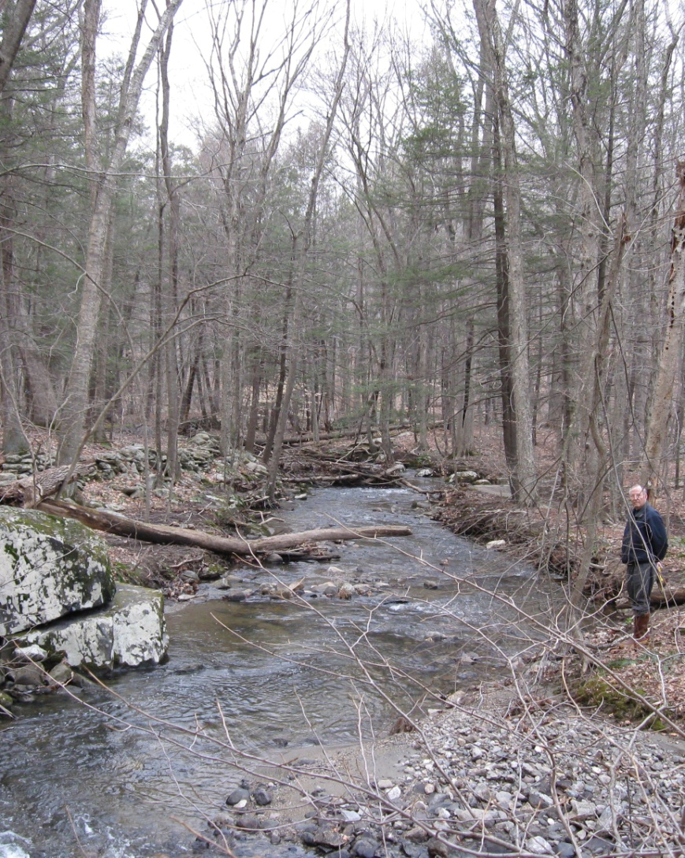
Obvious Trail Problems
Notes:
Some trail problems are obvious: bridge is needed; puncheon needs repair

Slide 34
Too Much Water
Notes:
Water is often a problem on trails. It is sometimes difficult to find the best solution.
Options for different situations including water bars, stepping stones, puncheon, relocation, …

Slide 35
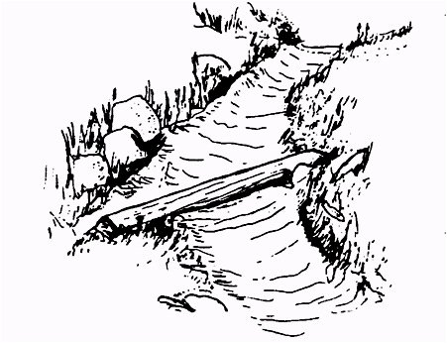
Water Bars
Clear debris from behind water bars regularly
Water flows
off tread
Water flowing down trail causes erosion
Notes:
Discuss how they work: only for trails on hills with one side higher than the other
Built by trail crew; maintainer must remove debris from behind water bars
Dirt on downhill side should be at the top of the water bar
Rake or scrape clean. Regular maintenance should not require aggressive digging. Avoid undermining the bar. Organic soils cleaned out from drainage should be deposited on the downhill side of the outflow ditch.

Slide 36
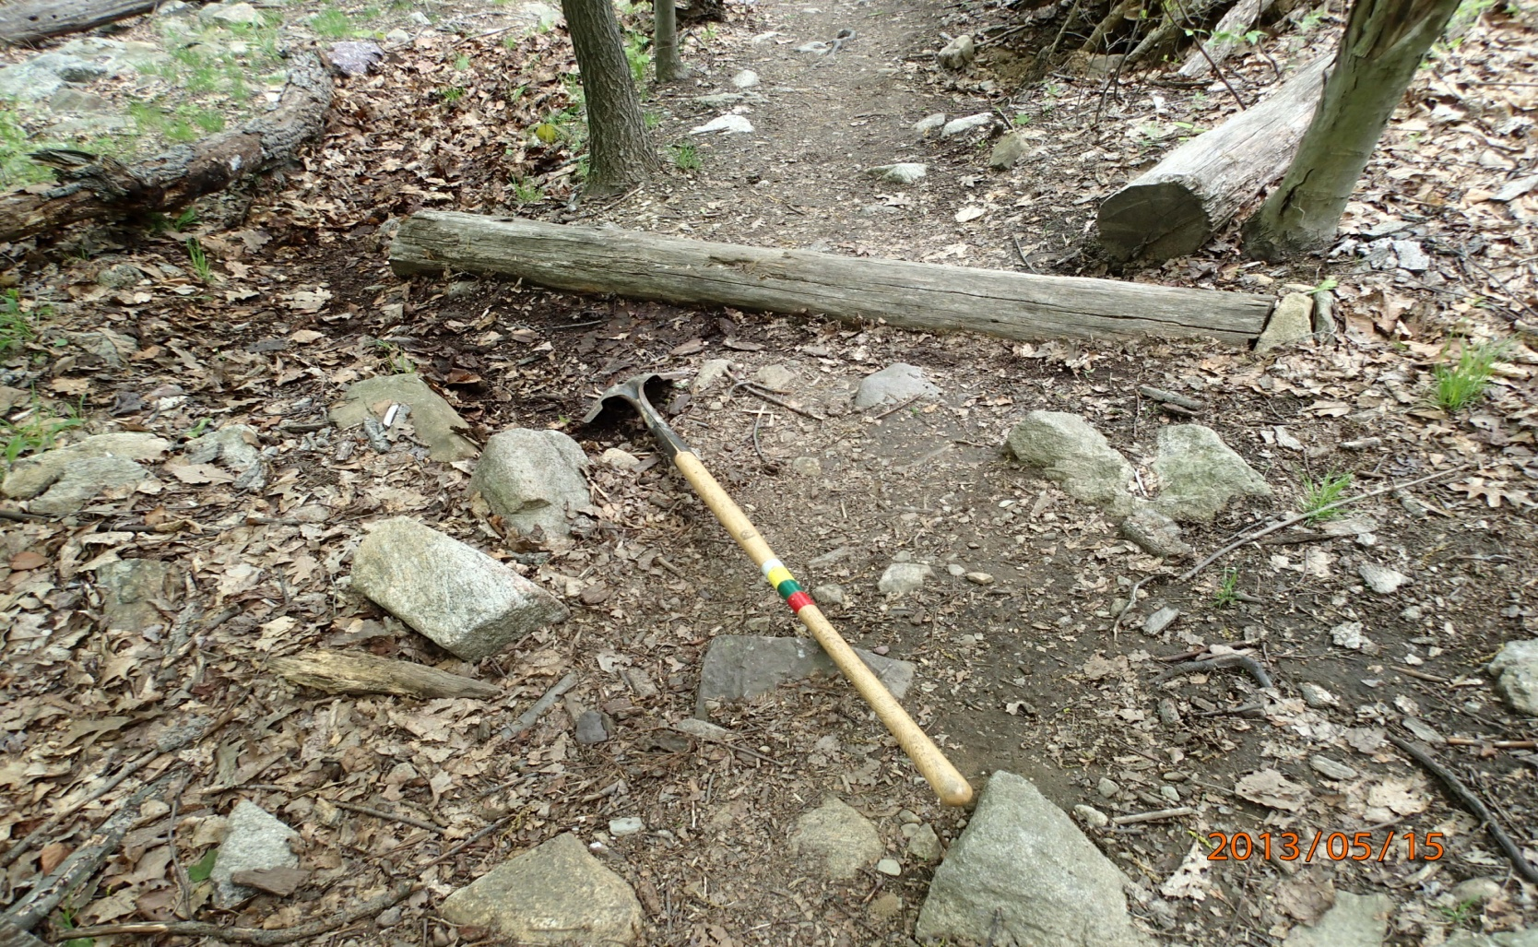
Water Bars
Shovel points in direction of water flow

Slide 37
Stepping Stones
Notes:
Highly effective in level wet areas where large stones are available
Trail crew will install larger stepping stones if needed

Slide 38
Puncheon
Notes:
Longer wet areas crossed by puncheon.
These puncheon shown are in seasonally wet areas that are heavily used

Slide 39
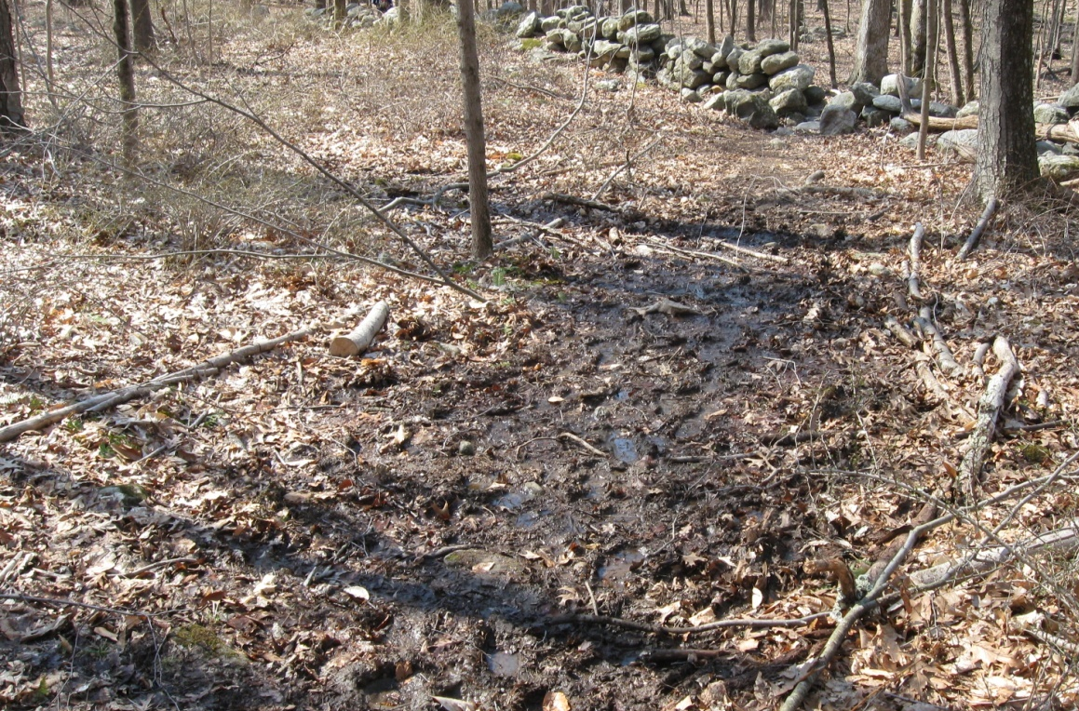
Should This Trail Be Relocated?
Notes:
Relocation may be considered if a clearly better location is available, but it isn’t always a good option.
What are other options? Stepping stones or puncheon are probably a better choice here.

Slide 40
Trail Relocations
Align trail with terrain so that you can
Minimize erosion
Maintain the treadway
Avoid wet areas
Make trail safer
Gain improved views or pass interesting features
Conform to landowner requests
Most relocations need approval
Talk with your supervisor first
Notes:
Emphasize that relocations need approval except for minimal ones in some cases

Slide 41
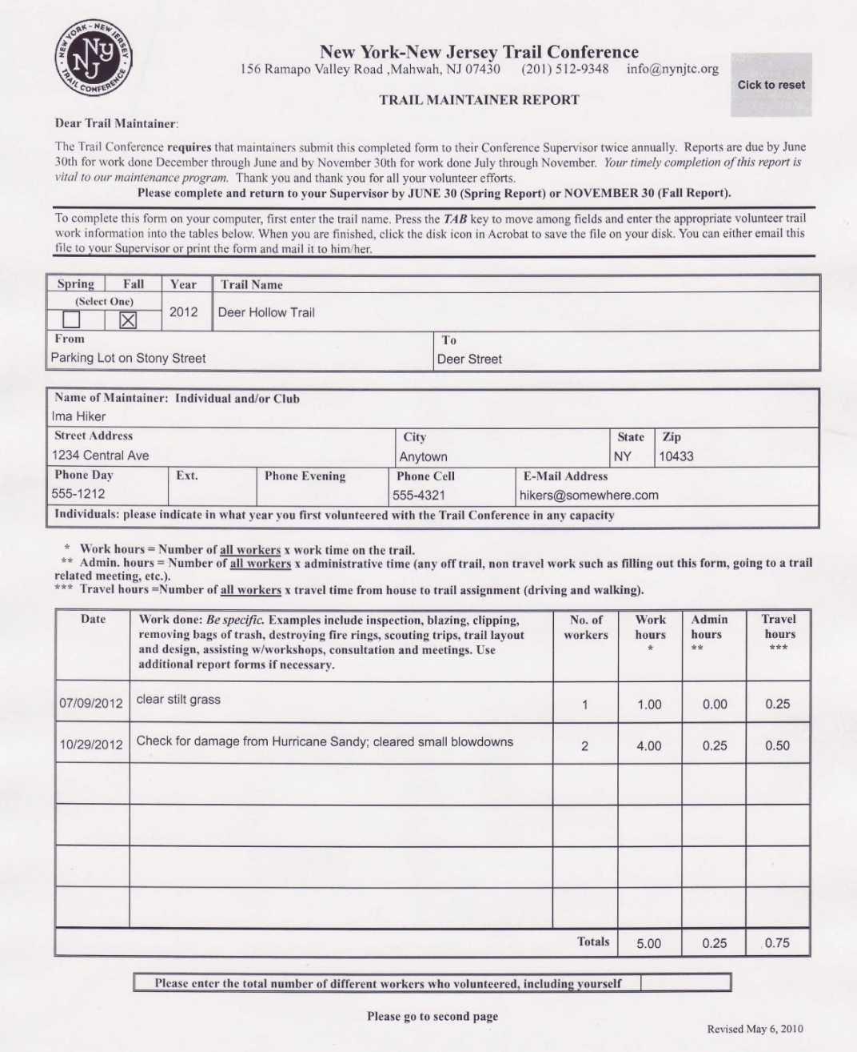
Reporting
Reports to supervisors are due June 30 and November 30
On-line reporting for each work trip is being developed
Notes:
Ask why reporting is important.
Emphasize need for information on trail condition and needs and use for obtaining grants and other support from agencies.
Have participants fill out form of what they did that day.
Remind them to let supervisor know about problems immediately, not when they send the report in.

Slide 42
Trail Maintenance Cycle
Clean up winter and spring storm damage
Notify supervisor of problems
Plan work
Clip after spring and early summer growth
Blazing
File spring report with supervisor
Spring
Summer
Winter
Fall
File fall report with supervisor
Check trail (if conditions permit)
Check trail
Clean up, trim as needed
Clean drainages
Complete projects
Notes:
Review what we have covered

Slide 43
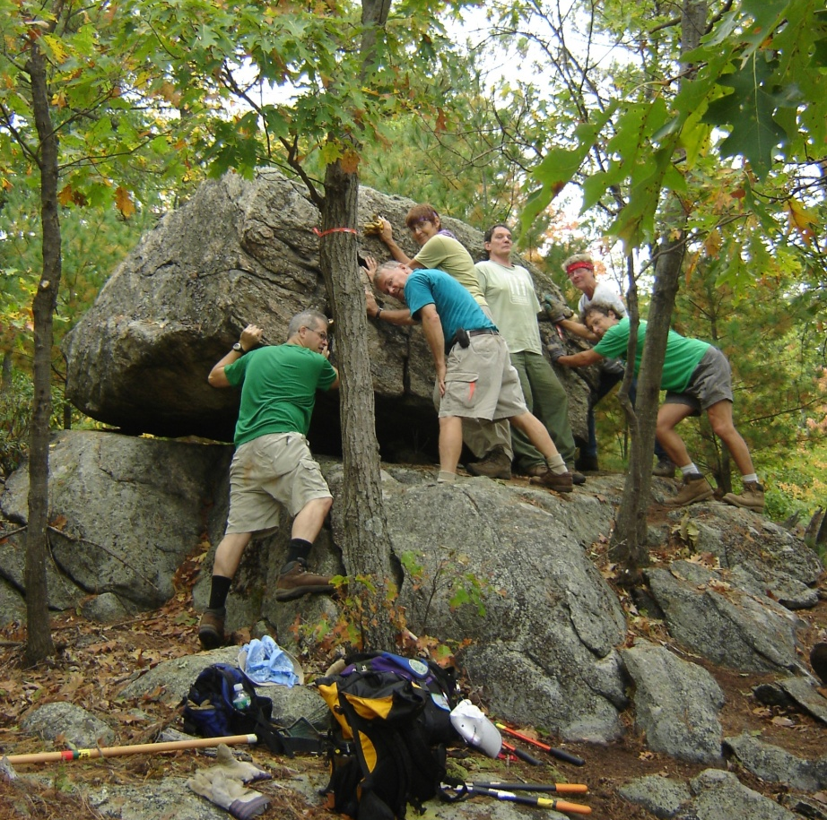
Volunteers Can Move Mountains! Join the Fun!
Notes:
Happy workers.
Have sign-up sheets and upcoming crews or training schedules available

Slide 44
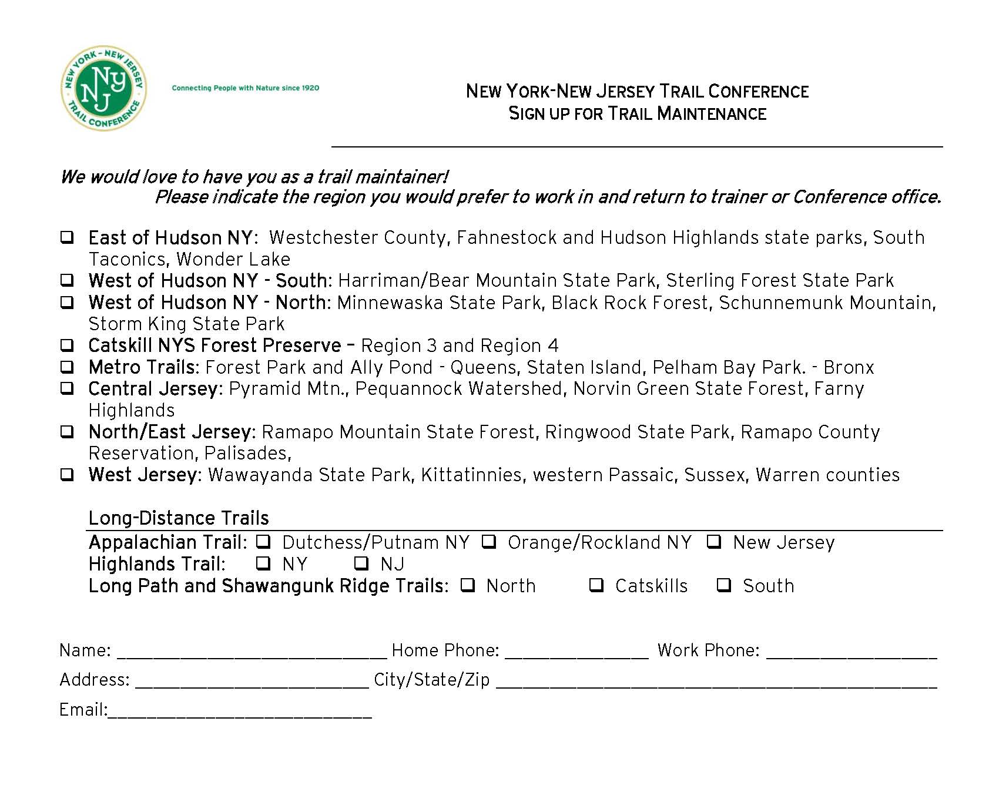
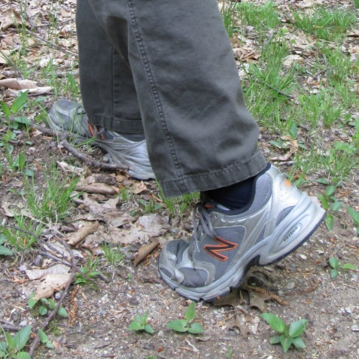
Next Step to Become a Maintainer
Notes:
Just as important - if you want to stop being a maintainer

Slide 45
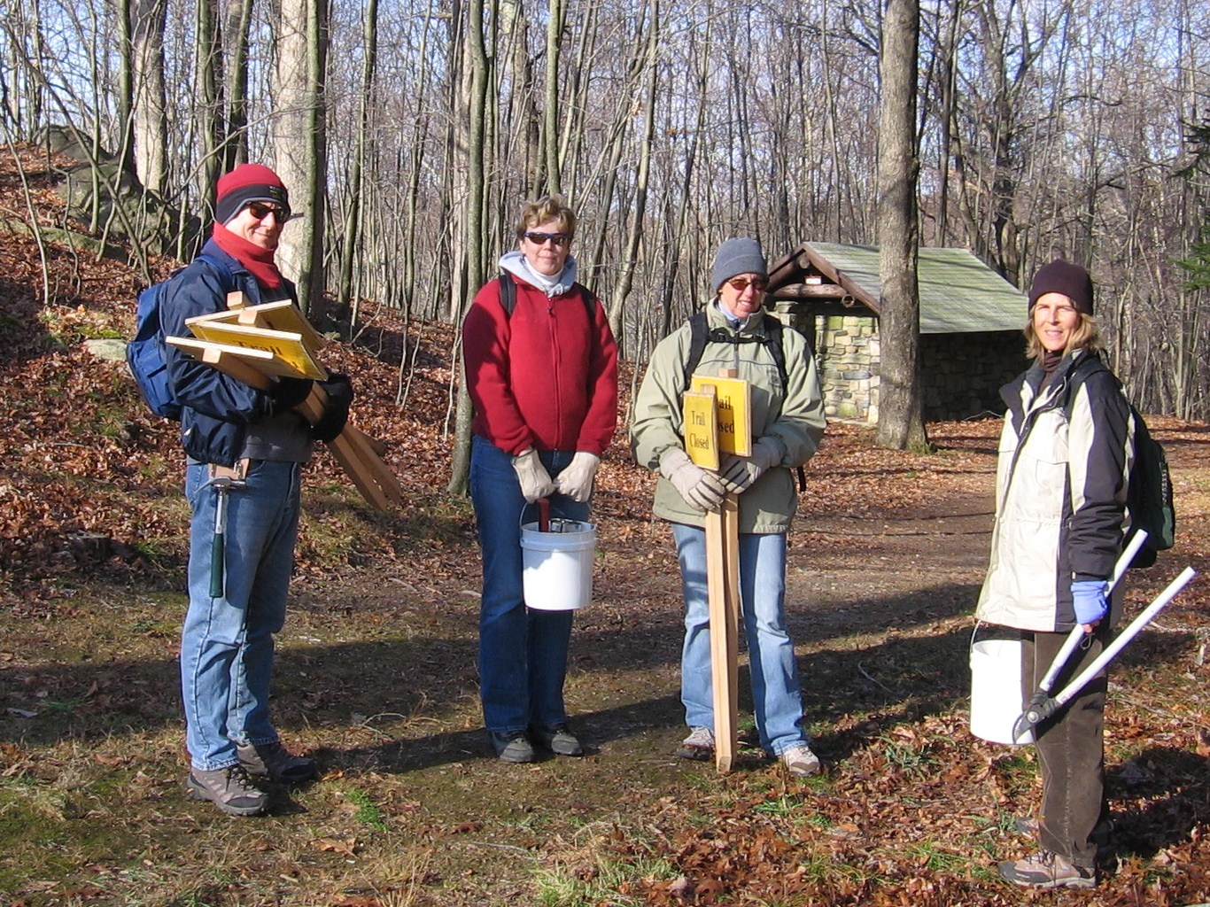
Thanks for Attending
Notes:
Have participants complete course evaluations and have them fill out Volunteer Interest forms – for region of interest.
Have a large envelope for evaluations

