Slide 1
Trail Maintenance 101
Date
Place
Instructors
Notes:
Welcome Maintenance 101
Introduce self and assistant

Slide 2
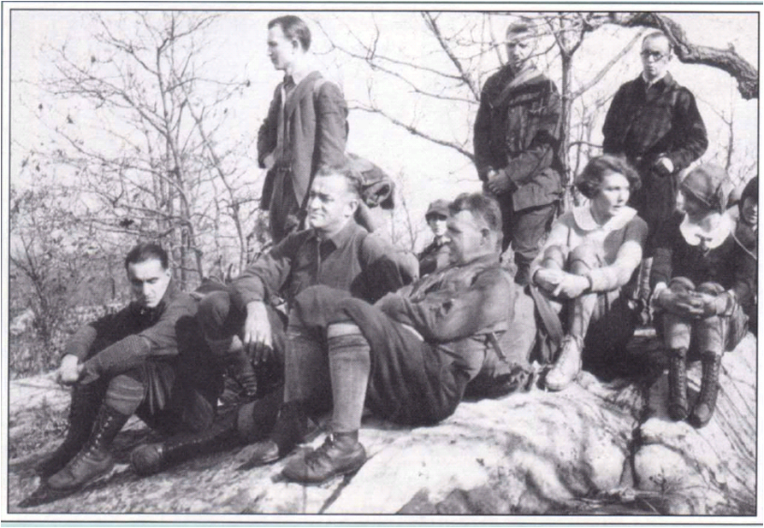
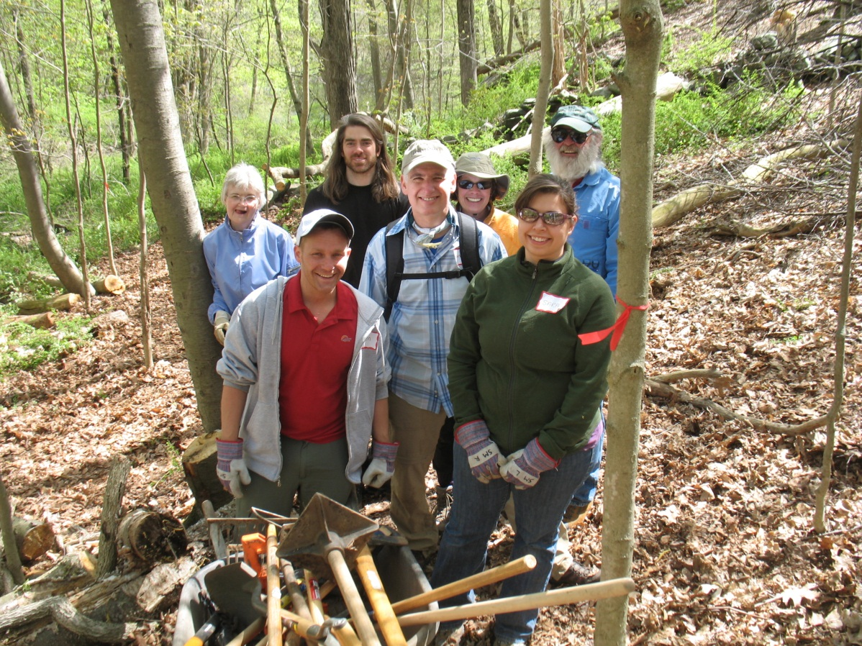
Changes since 1920
Notes:
Volunteer based organization with staff support
Began in 1920
Currently maintains about 2,000 miles of hiking trails
Members contribute 60,000 hours annually
For more information: www.nynjtc.org

Slide 3
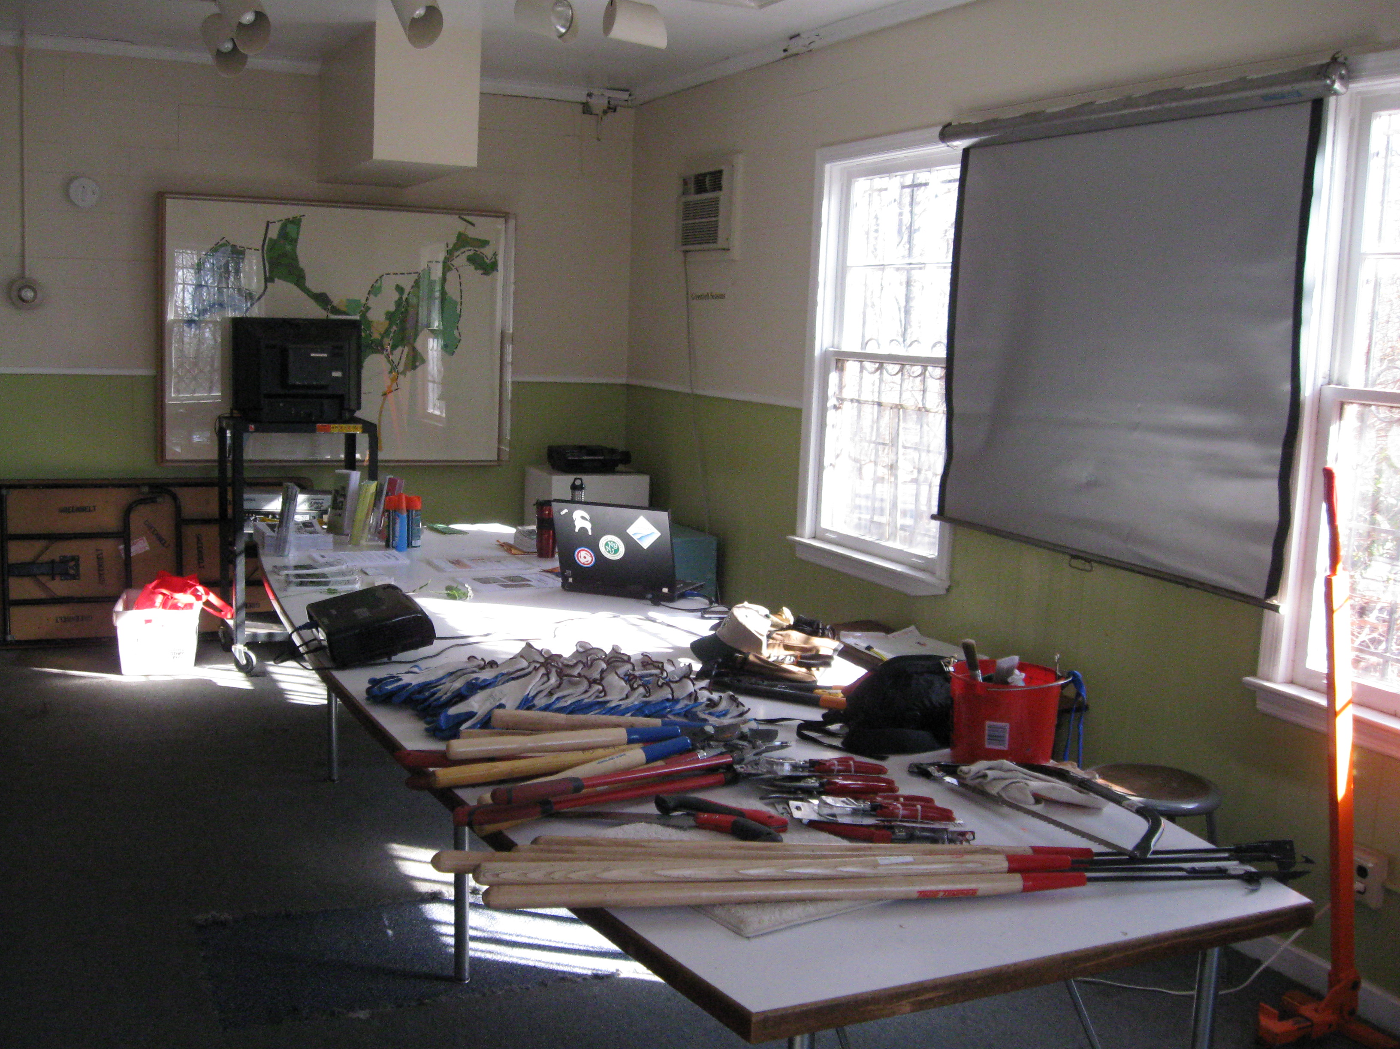
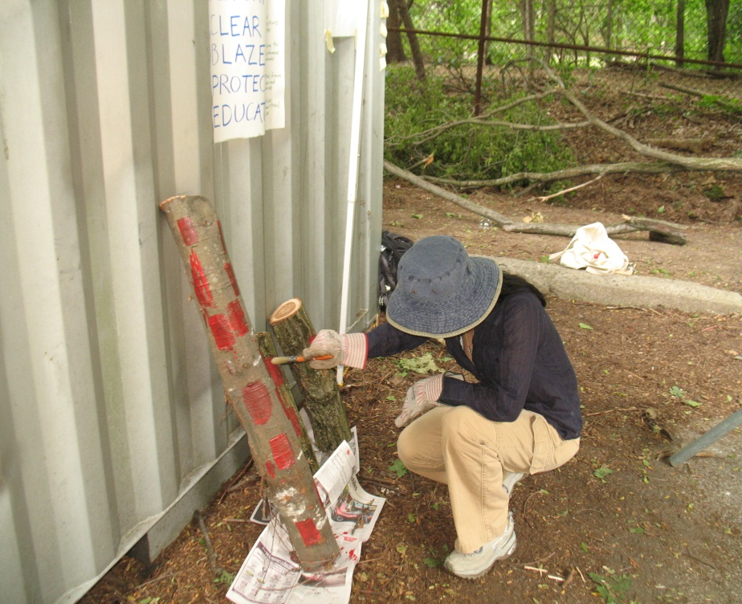
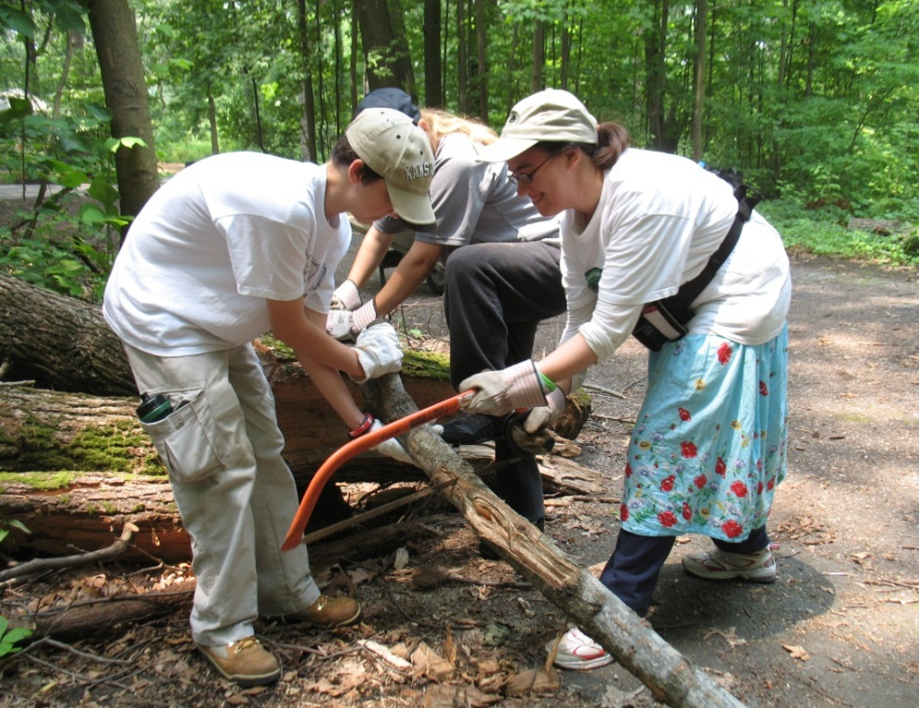
Indoor presentation
Outdoors hands-on practice
Notes:
Agenda for the day:
Welcome and introductions
Indoors for the morning
Lunch
Outside for hands-on practice
Back inside for wrap-up

Slide 4
Trails Council Chair
Regional Trail Committee Chair
Maintainers, Monitors, and Crews
Trail Supervisors and Trail Crew Chiefs
Notes:
Description of volunteer pyramid
Roles of volunteers

Slide 5
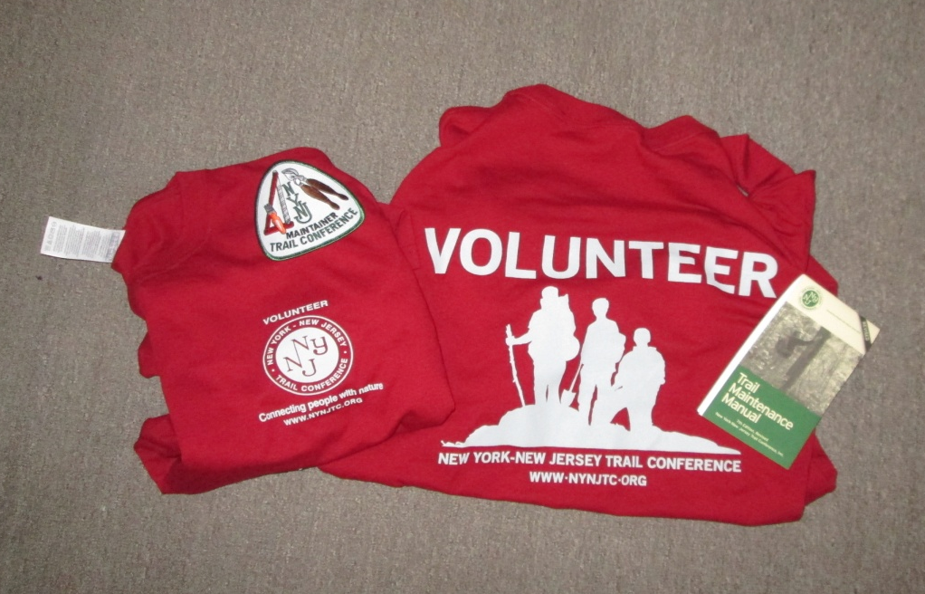
Maintainers are VIPs!
Caretakers of a trail
Public face of the Trail Conference
Educators to the public
Notes:
Maintainers must be members of the Trail Conference or a member of a maintaining club
public face/ambassadors when you meet the hiking public. Give you T shirts
Volunteer insurance if hurt
10% discount at many outdoor stores

Slide 6
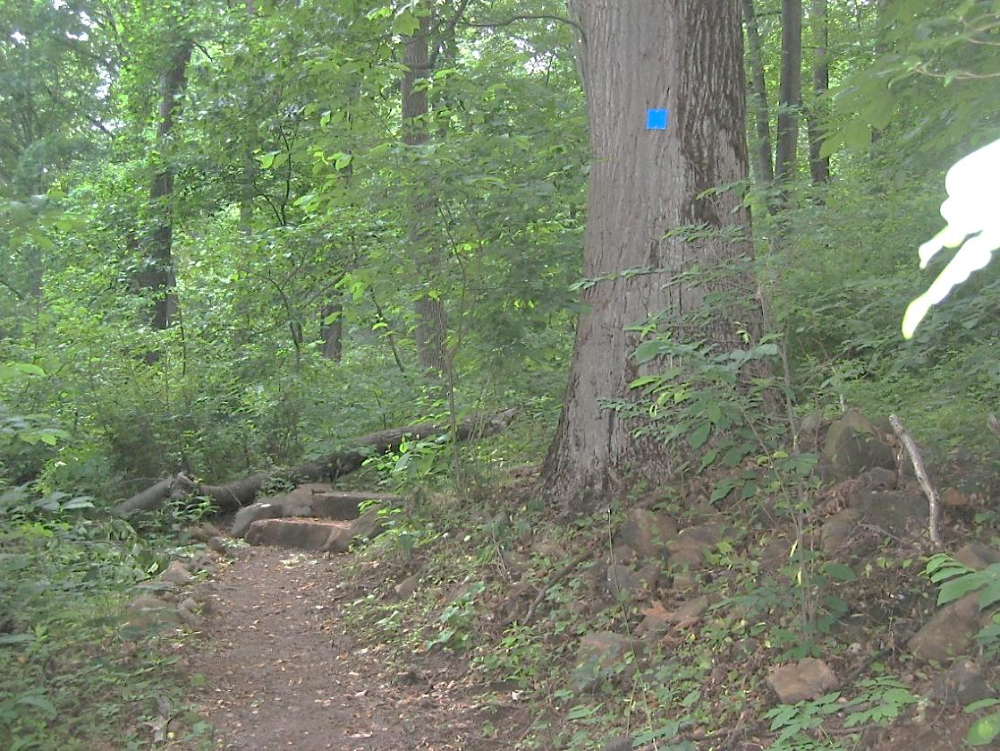
Trail Terms
Trail Marking
Trail Corridor
Trail Structure
Trail Tread
Notes:
Let’s get started with some terminology.
When we refer to a” trail” we often are referring to one or more of these components. Terminology is important because the trail as a whole is a sum of these parts, for example when people refer to Trail erosion, they are nor referring to the corridor eroding – but to the actual earthen tread.
Marking can be blazing, signs or cairn.
Explain each of the major trail components.

Slide 7
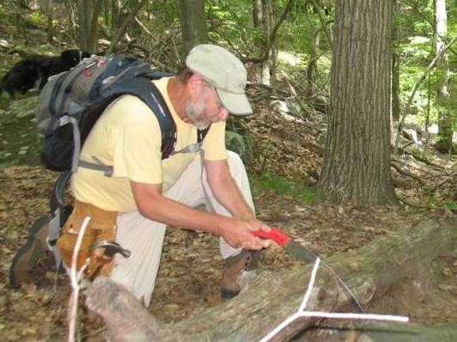
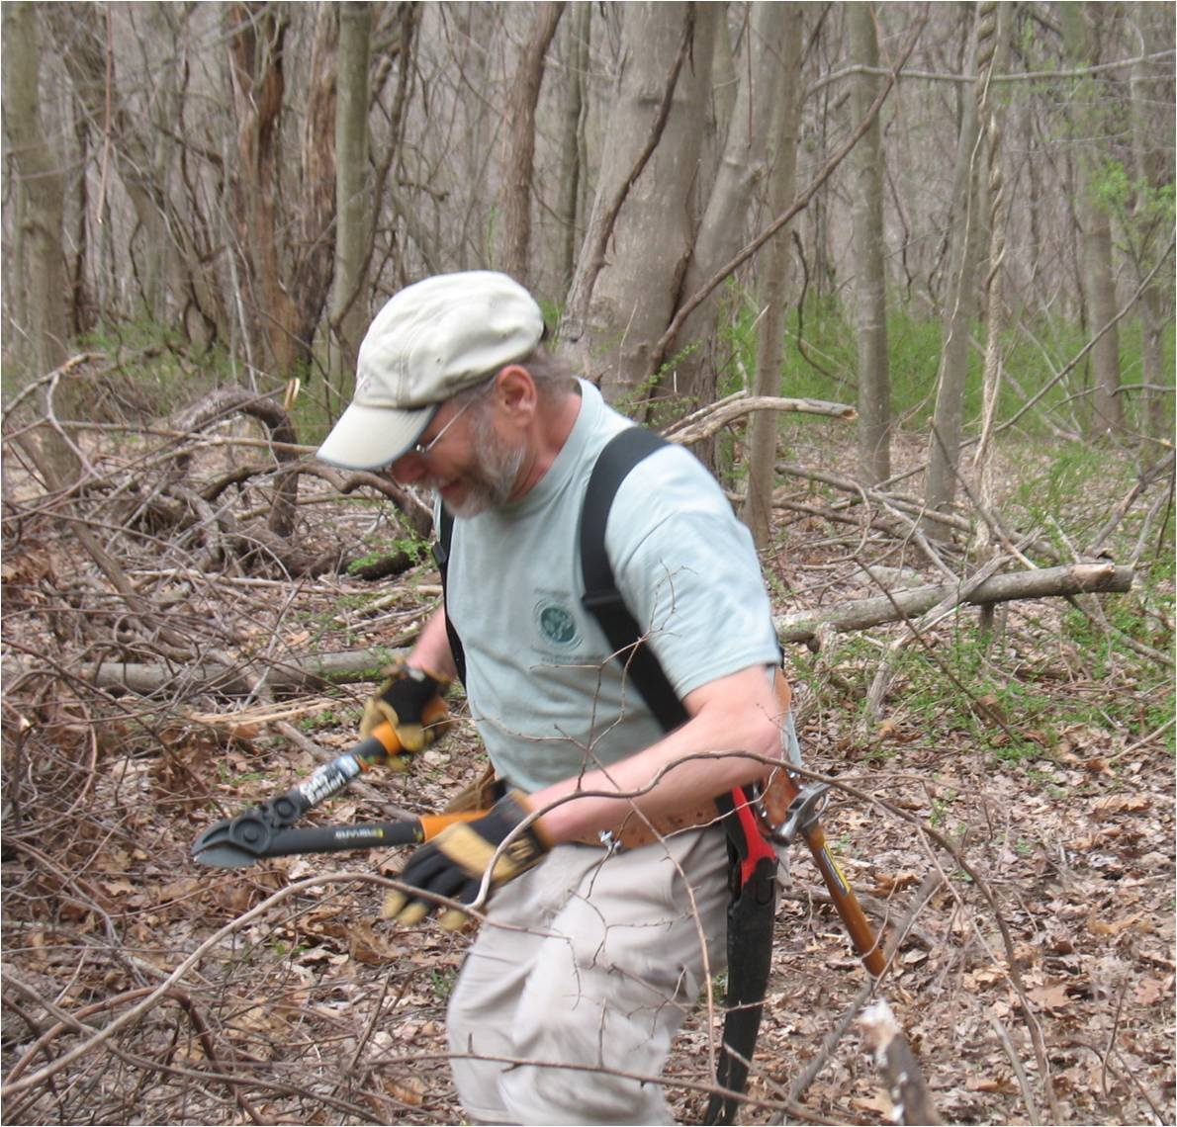
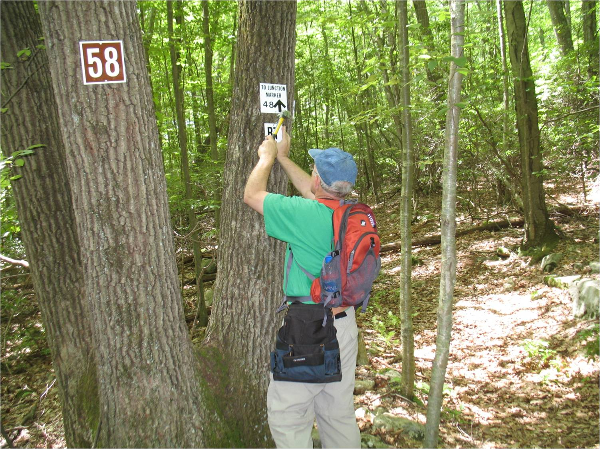
Notes:
What does a maintainer do? clear brush, blaze

Slide 8
What problems or situations do you think you will find on the trail ?
Notes:
Ask participants to name things or situations they may find on the trail as they are maintaining.
List them on a whiteboard or flip chart.
Using the list the participants came up with, ask which items they feel pertain to safety for themselves as a maintainer and to hikers using the trail
Circle the items or mark them with a color.
You will refer and add to this list throughout the class.

Slide 9
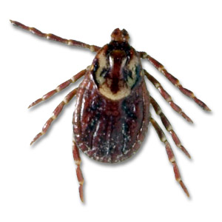
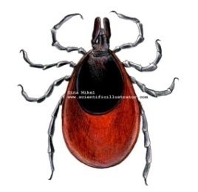
Deer Tick Dog Tick
Stinging
Insects
Notes:
Deer Ticks carry Lyme Disease
Tuck pant legs into socks
Wear light colored clothing
Check often for ticks on clothing and skin
Prepare clothing in advance if using repellants

Slide 10
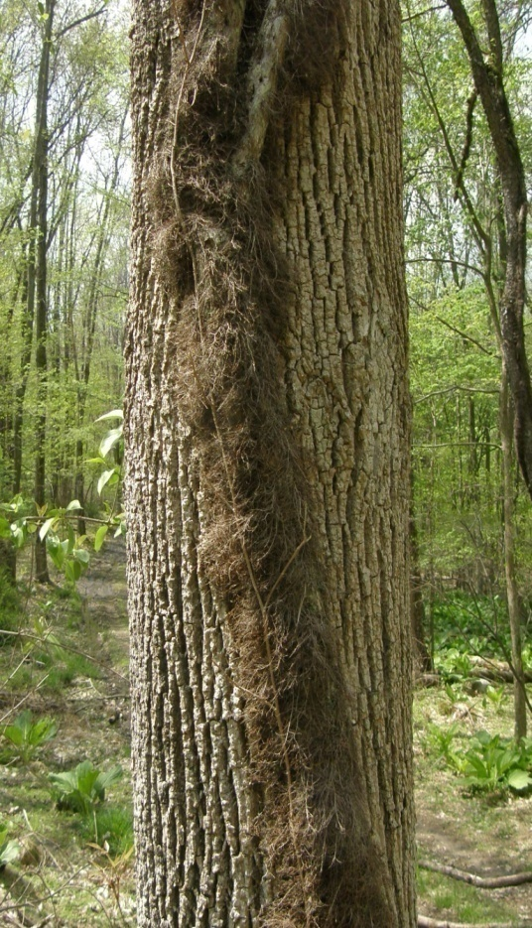
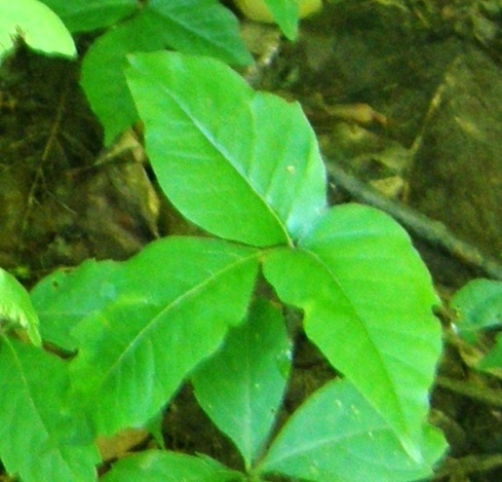
Poison Ivy
Notes:
Use great care in clearing
Leaves of three – Let them be
The hairy vine is also toxic

Slide 11
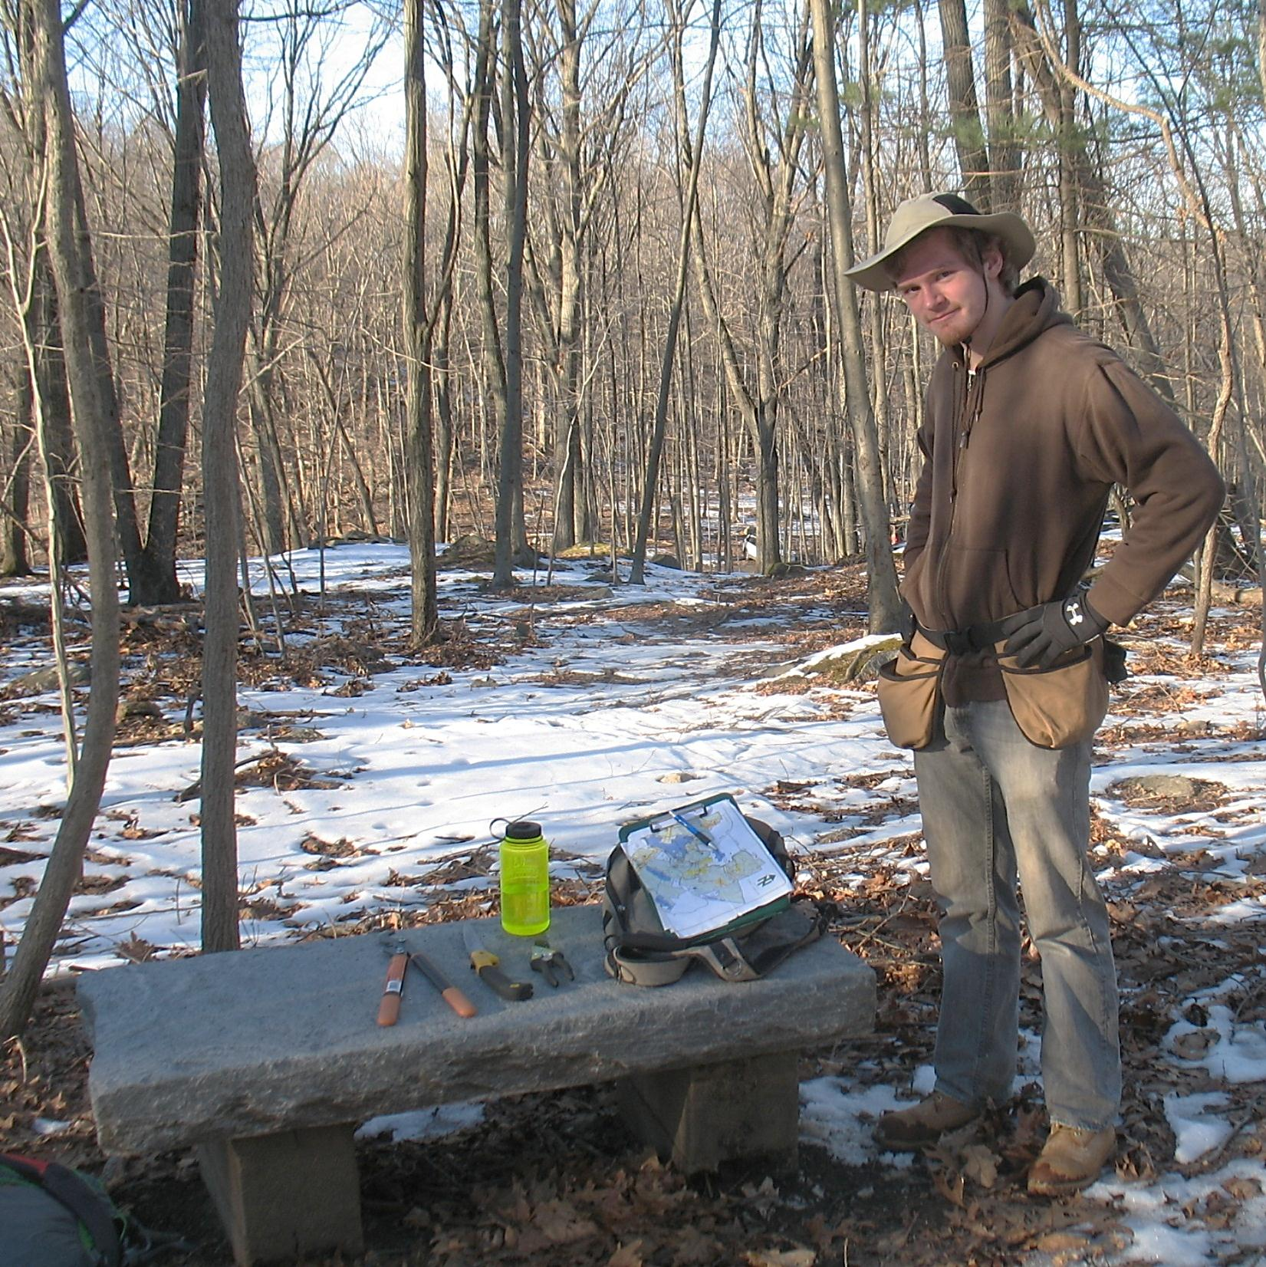
The well prepared maintainer has
Water, food,
Map
Extra clothes
First Aid kit
Safety glasses
Notebook & pen
Gloves
Tools
Sturdy Shoes
Notes:
Be prepared to be outside
A paper map so they can mark where problems are and a notebook to record note of what you have done or need to do

Slide 12
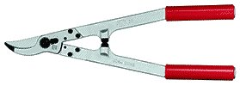
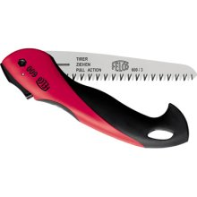
Tools for Clearing
Loppers
Hand pruners
Bow saw (24-inch blade best) or folding saw
Litter bags
Sturdy work gloves
Other tools you might want
Weed whip for low-growing plants
Notes:
Bring a good collection of tools to the class. Save discussion of the merits of the tools until you are outside
Remember to sharpen the tools. Dull tools don’t cut.
Allow people to look at them during the class break. Some attendees may never have seen some of the tools used.

Slide 13
Clearing the Corridor
Before
After
Notes:
Brushing against vegetation is not something hikers like – especially barberry

Slide 14
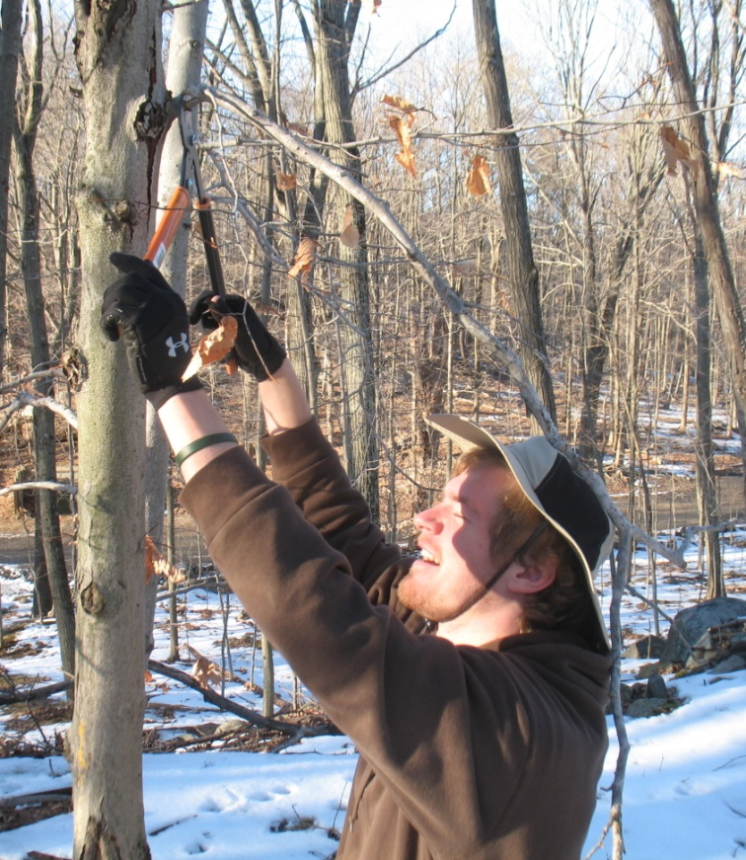
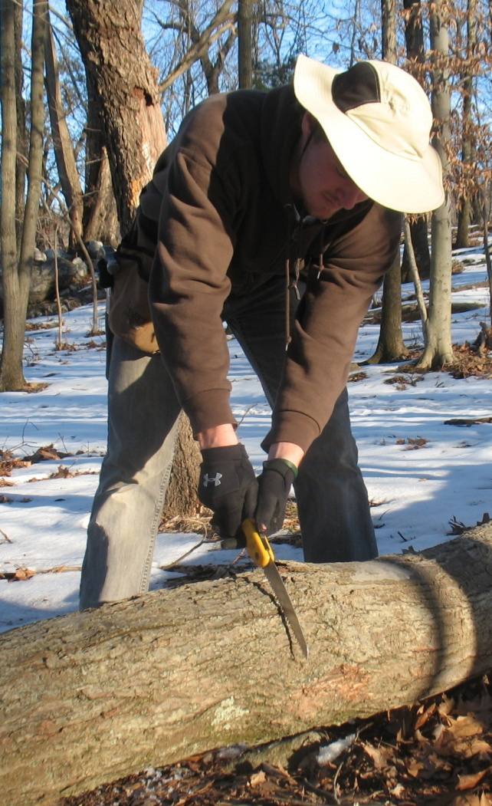
Learn Safe Practices
Use Common Sense
OW!
Notes:
Clearing includes clipping back brush and branches
Safety first
What is the person on the left doing wrong? What about the one on the right.
Hard hats are cheap protection – buy one

Slide 15
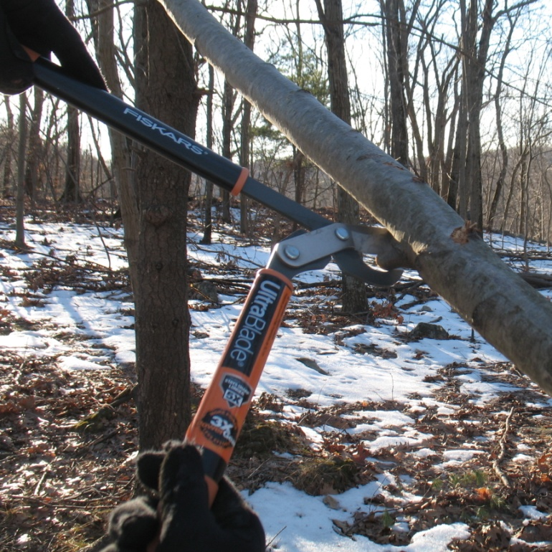
How to Cut Branches
Notes:
We will practice in the outdoor session

Slide 16
Removing small blowdowns
Notes:
What is he doing wrong?

Slide 17
DANGER
Saplings or smaller trapped limbs can “snap” or “spring” and can cause serious injury. Release the tension carefully with shaving cuts from underneath.
Notes:
Saplings or smaller limbs can become trapped under larger trips and can cause serious injuries if they “snap” or are release to quickly
Carefully untangle trapped limbs
Partially cut the outer curve to release tension on springpoles
If in doubt – mark dangerous limbs with forester’s tape and leave for a sawyer or crew

Slide 18
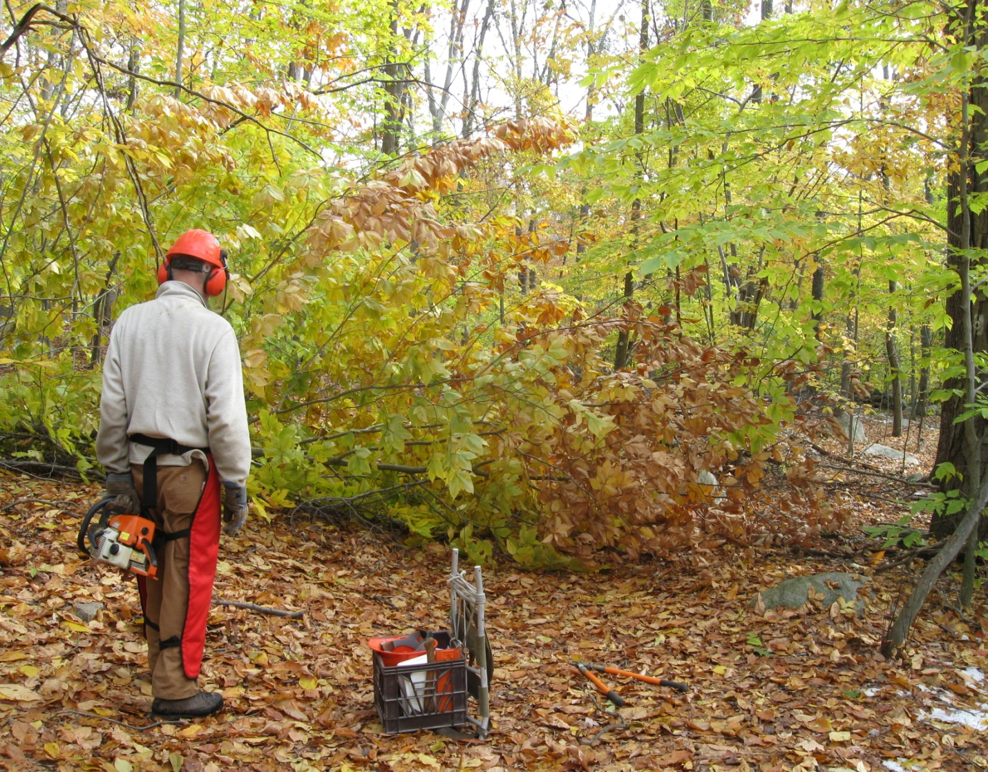
Certified sawyers or land managers will remove large trees or limbs over
6-8 inches
Notes:
Leave large trees or limbs over 6-8 inches, but try to cut a path around the mess or limb the tree so it is just a step over

Slide 19
But you to let your supervisor Know
Size (diameter)
Position (across, along or hanging over trail)
Location (notable landmark or distance)
Take a photo

Slide 20
If asked to help, you are a swamper
Assists the sawyer in moving sawed limbs and logs
Observes safety practices

Slide 21
Maintaining the Tread
Clear debris from low lying spots on the trail.
Notes:
Clear debris off the trail that traps water. Report major erosion
See P 27-31 Trail Maintenance Manual

Slide 22
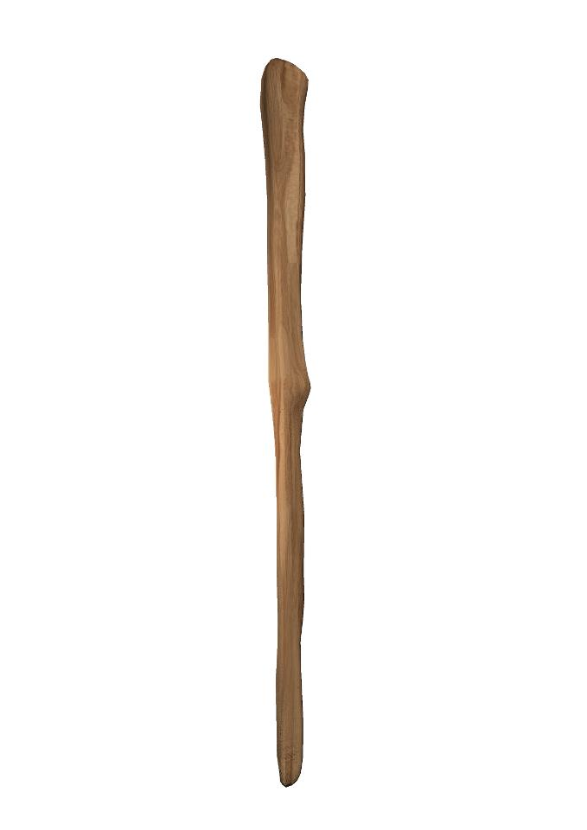
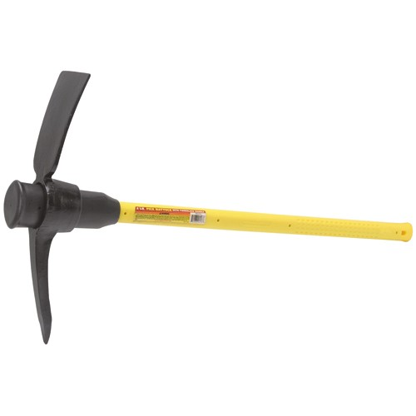
Tools for Maintaining Trail Tread
Pick Mattock
McLeod
Stick
What are these tools designed for?
Notes:
Ask participants what they think the different parts of these tools are designed for – cutting, moving rocks, moving dirt, clearing leaves and debris
If you have a lot of water bars or drainages on your trail segment you may want to use tread tools.
If you maintain drainages regularly you can often just use a sturdy stick you find on the trail
Spend a day with a trail crew or take a more advanced workshop to learn how to safely use these tools.
Your supervisor will tell you about safe use of long-handled tools if they are needed for your trail segment

Slide 23
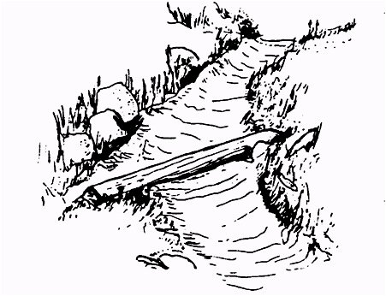
Drainage Cleaning and Maintenance
Clear debris from behind water bars regularly
Direction of water flow
Water flows
off tread
Notes:
P 27-31 Trail Maintenance Manual – Clearing water bars
Discuss and diagram or show example of trail on a steep slope. Effects of water running down the slope. Why and how to drain water off the trail.
Ideally trail are built sustainably and are not parallel to steep slopes.
Built by trail crew, cleaned by maintainer
Remove debris from behind water bar.
Dirt is on downhill side so trail level is at top of water bar
Rake or scrape clean. Regular maintenance should not require aggressive digging. Avoid undermining the bar. Organic soils cleaned out from drainage should be deposited on the downhill side of the outflow ditch.

Slide 24
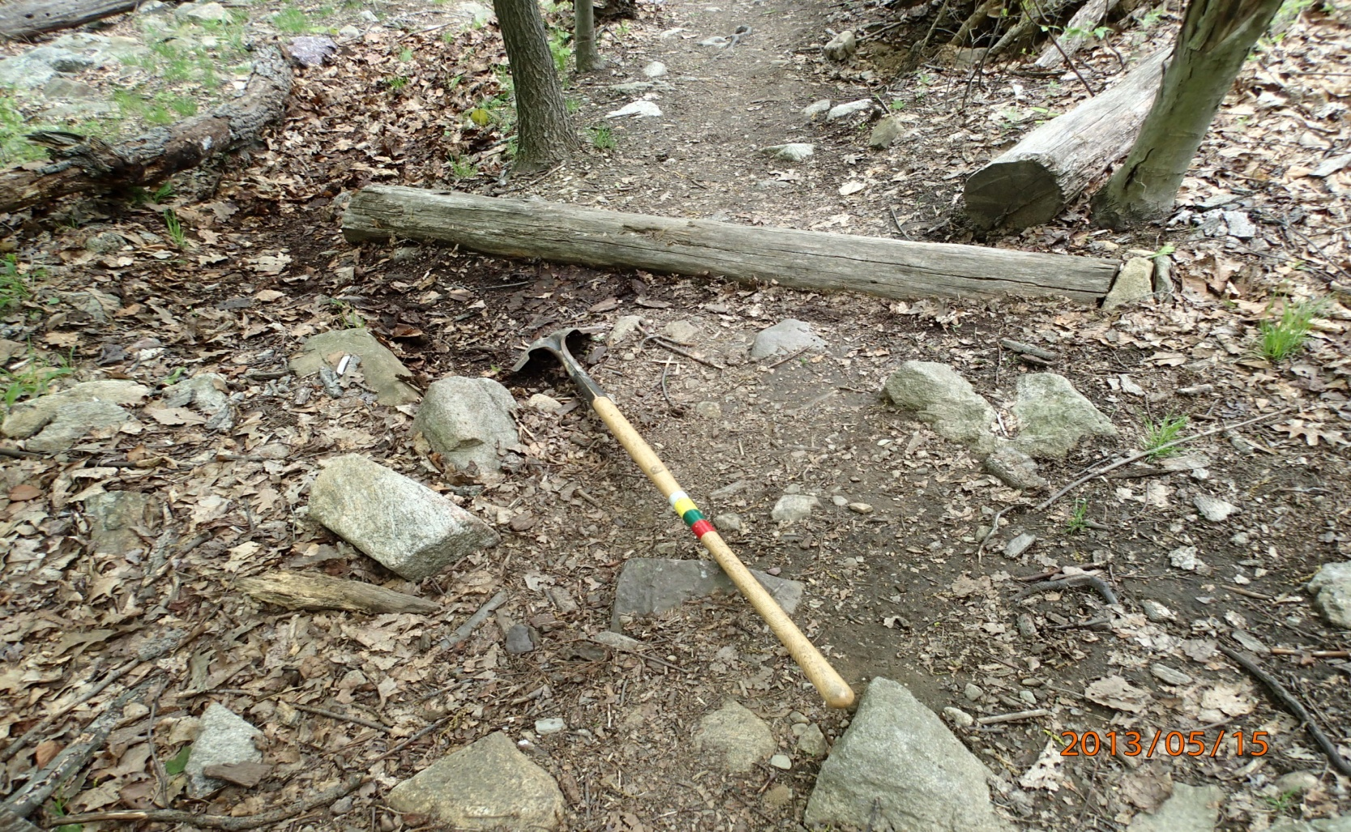
Water Bar
Shovel points in direction of water flow

Slide 25
Stepping Stones
Notes:
A crew will install larger stepping stones if needed

Slide 26
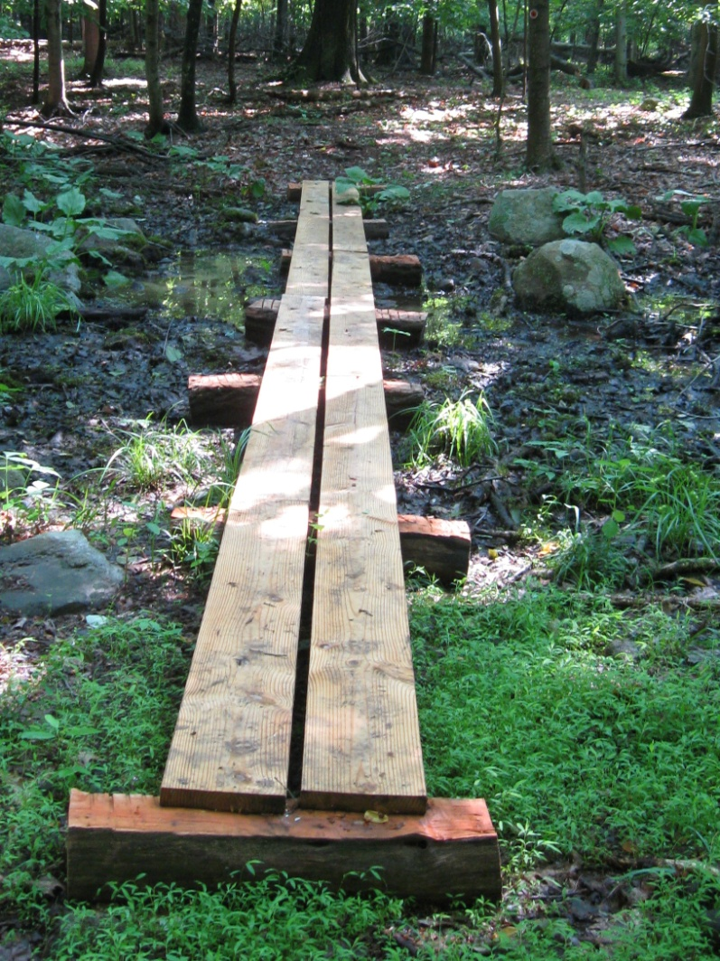
Puncheon
Notes:
Longer wet areas crossed by puncheon.
These puncheon shown are in seasonally wet areas that are heavily used

Slide 27
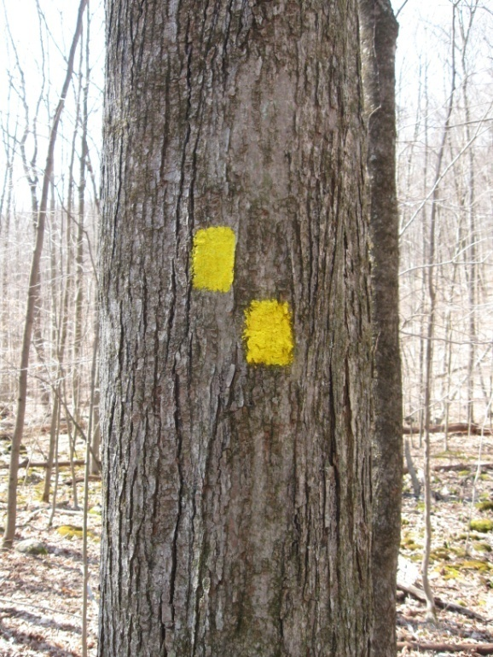
Marking the Trail
Paint Blaze Tag Blaze
Notes:
Type and color of blaze is a landowner decision.
Supervisor will let you what to use on your trail

Slide 28
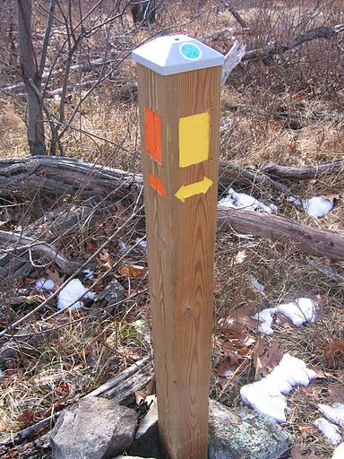
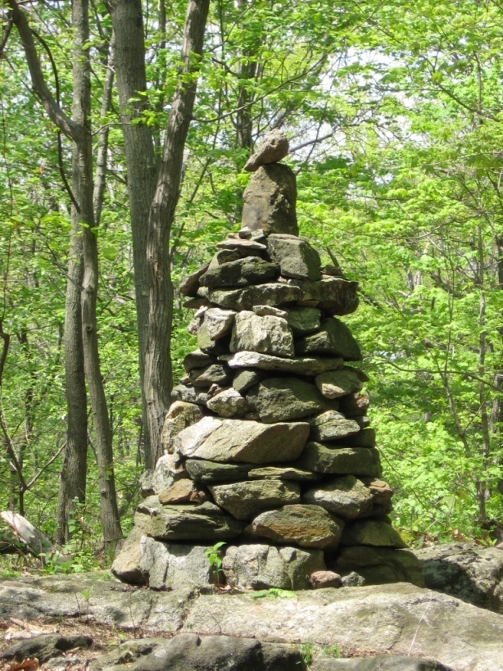
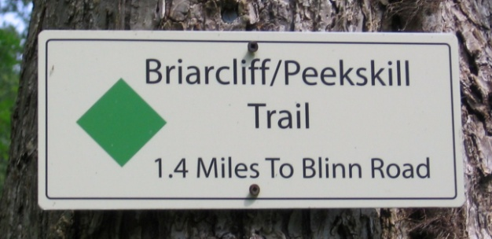
Other Markings
Notes:
Cairns are a trail structure and must be built according to a standard appropriate to be structurally sound. Refer to a crew chief or resources at the TC office in Mahwah for further information on building cairns.
Signs and posts come in many styles with a variety of different information. The Land manager must approve signs and posts prior to installation

Slide 29
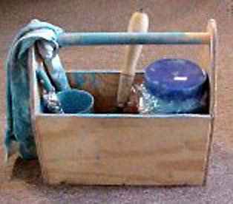
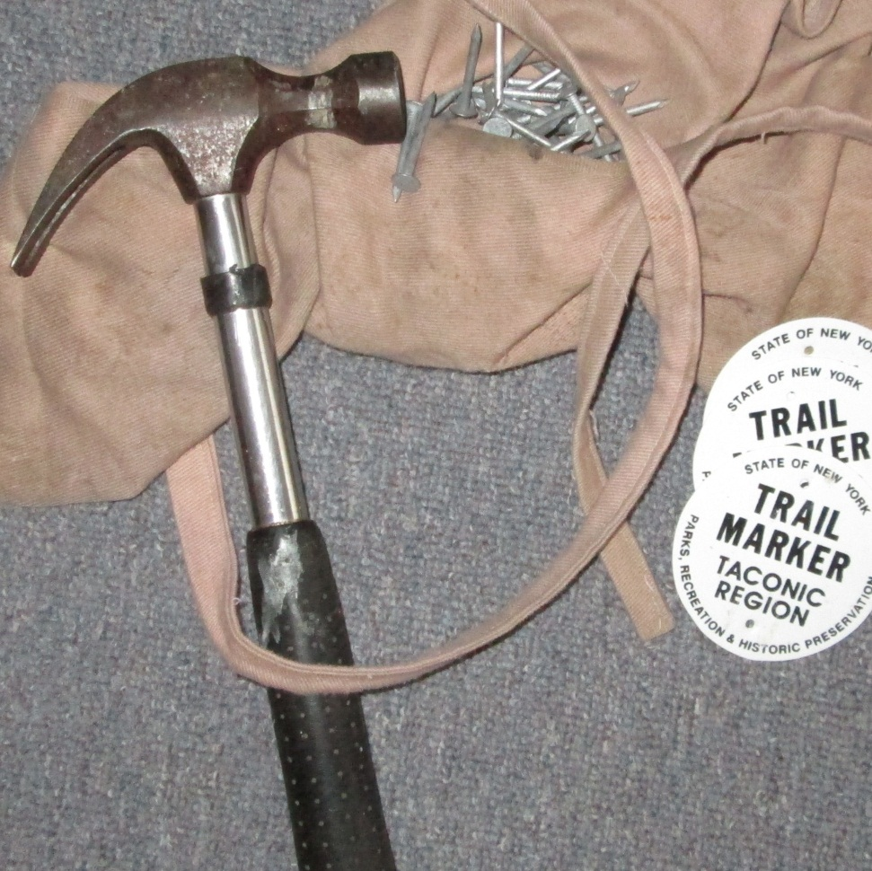
Blazing Tools
Notes:
Supervisor will tell you whether you have blazes or tags.

Slide 30
Where to put blazes
Notes:
Near the trail, at eye level, avoid dead trees, make sure there is a contrast between tree and blaze, needs to face the hiker – not the path

Slide 31
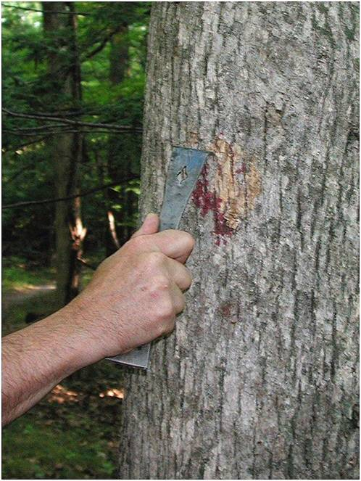
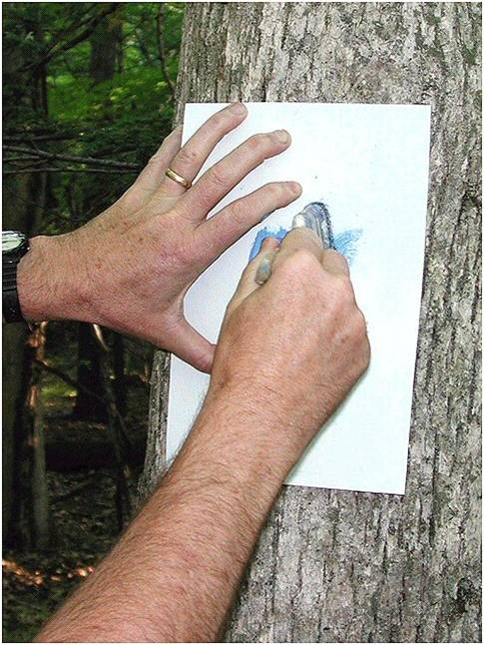
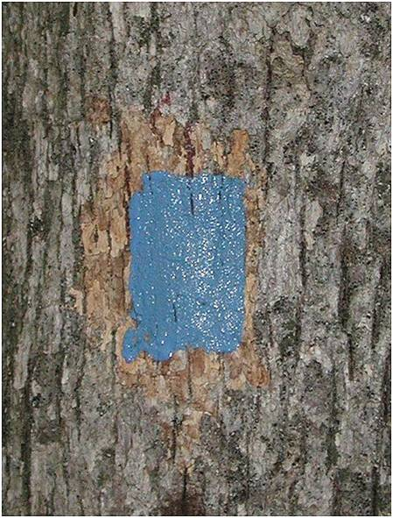
Notes:
Scrape, use template, done
To prevent messy templates – use sharpie to outline blaze, then paint

Slide 32
Paint Blazing Tools
Scraper
Brush – 1 to 1.5 inch wide with cup and plastic wrap
Paint in screw top jar
Template
Equalizing spray paint (gray and brown)
Rags, disposable gloves
Plastic bag(s)
Notes:
Supervisor will tell you what color
Scrape trees with rough bark to have a smooth painting surface; never scrape through the bark to the cambium layer.
Use a template to get accurate blaze size and shape: 2x3 inch, except 2x4 for Long Path and 2x6 for AT
Use a small brush
Avoid blazing if rainy or temperature is below 50 degrees

Slide 33
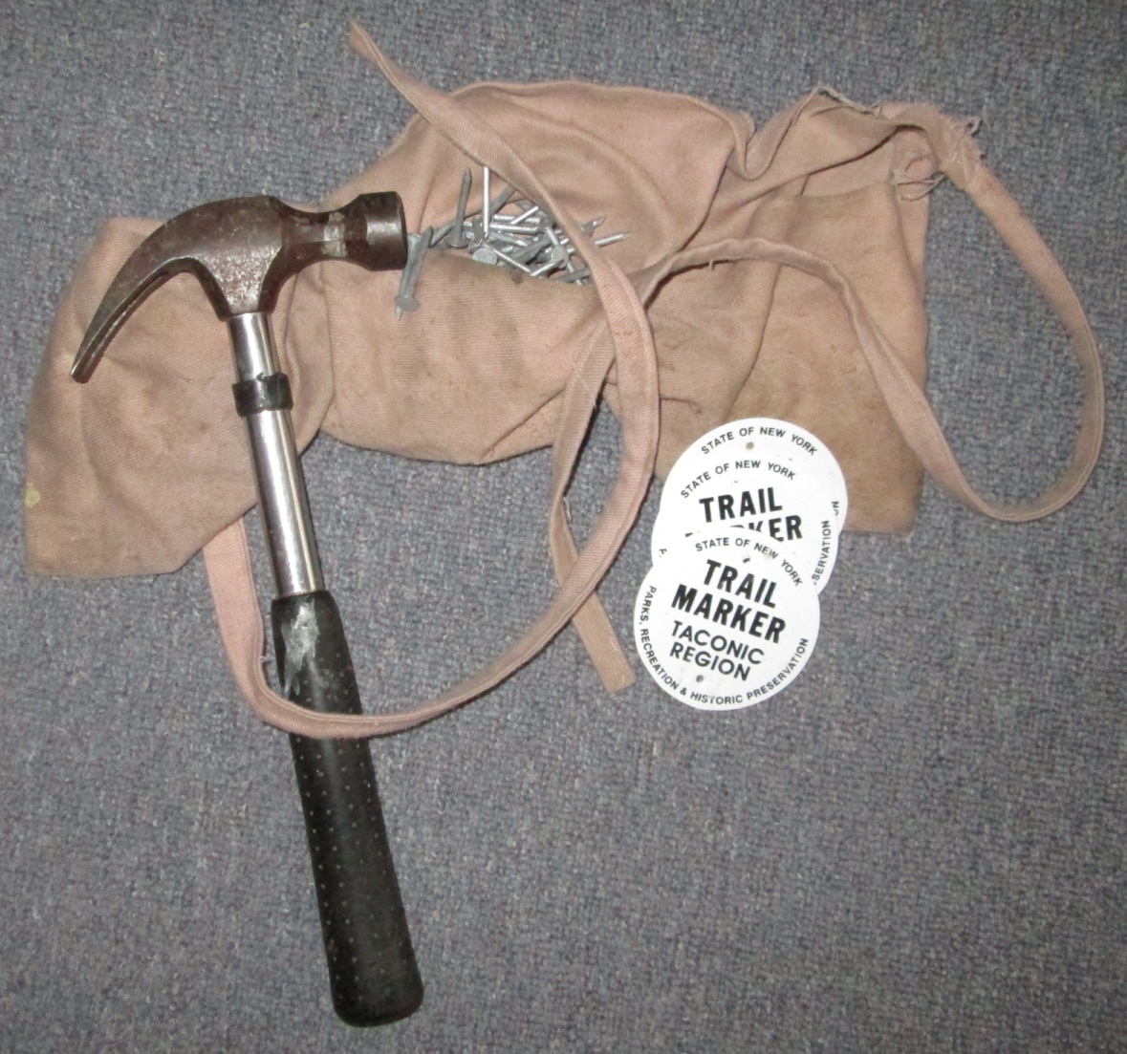
Tag Blazing Tools
Hammer
Nails
Tags
Pouch
Notes:
Some parks require aluminum nails.

Slide 34
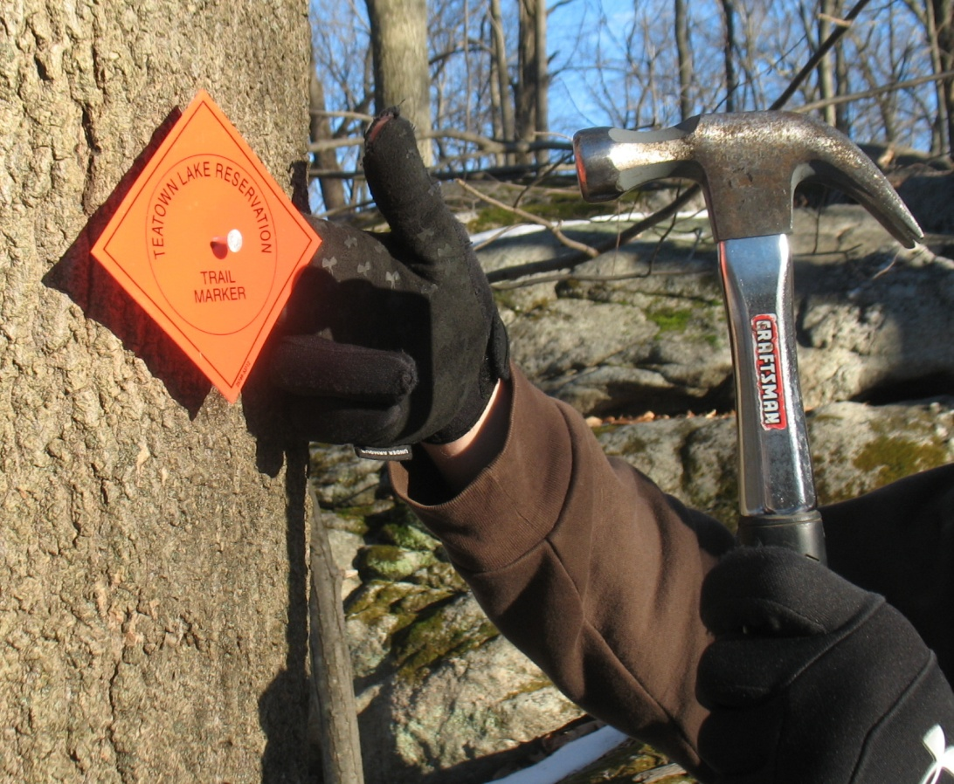
Tag Blazes
3/4 inch
Nail
Blaze
Tree
Nail
Notes:
Use 2 inch galvanized roofing nails unless a park wants aluminum nails
Do not nail tight against tree--allow at least 3/4 inch for growth
Use 2 nails, one near top and one near bottom, never at sides; if your trail partner says one nail, your supervisor will tell you

Slide 35
Blazing Turns
If nothing to blaze before the turn, place turn blaze
Put confirmation blaze a short distance past the turn
Place turn blaze before the turn
Place turn blazes at turns of 45 degrees or more
Trail
Notes:
Be careful that the blaze after the turn is not visible before the turn.
In an open understory or other area where the line of site is clear, hikers will be tempted to cut the corner when later blazes are obvious.

Slide 36
Blazing Two Trails on the Same Treadway
Place blazes for both trails on the same trees, one above the other in the same order
Blazes for long-distance trails such as the AT should be above blazes for local trails
Appalachian Trail blaze
Local trail blaze
Trail

Slide 37
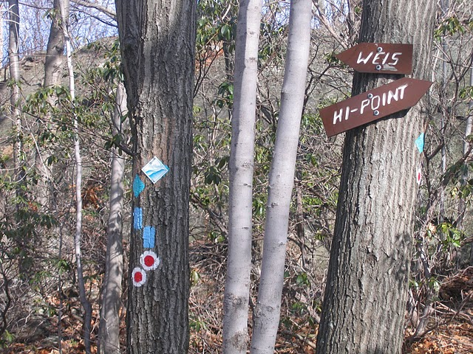
Turn blazes for three trails
Notes:
Gets confusing with multiple trails. Be neat as possible.

Slide 38
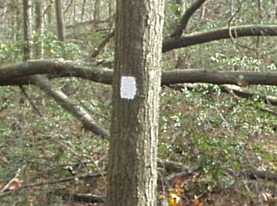
Blaze Patterns
Standard
Blaze
Right Turn
(upper blaze shows direction of turn)
Start of Trail
End of Trail
Notes:
Blaze Patterns. Importance of standard colors and markings. Lets try blazing.
Tips to remember start and finish blaze:
A-shape like an arrow down the trail
V-shape for victory – reached the end of the trail

Slide 39
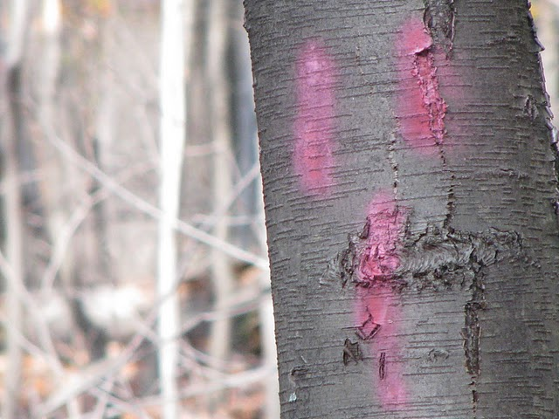
Can you spot the problems?
Notes:
Sloppy, faded and old paint blazes.
Blazes hammered in too far. Nail on tags – nails must be pulled out periodiclally

Slide 40
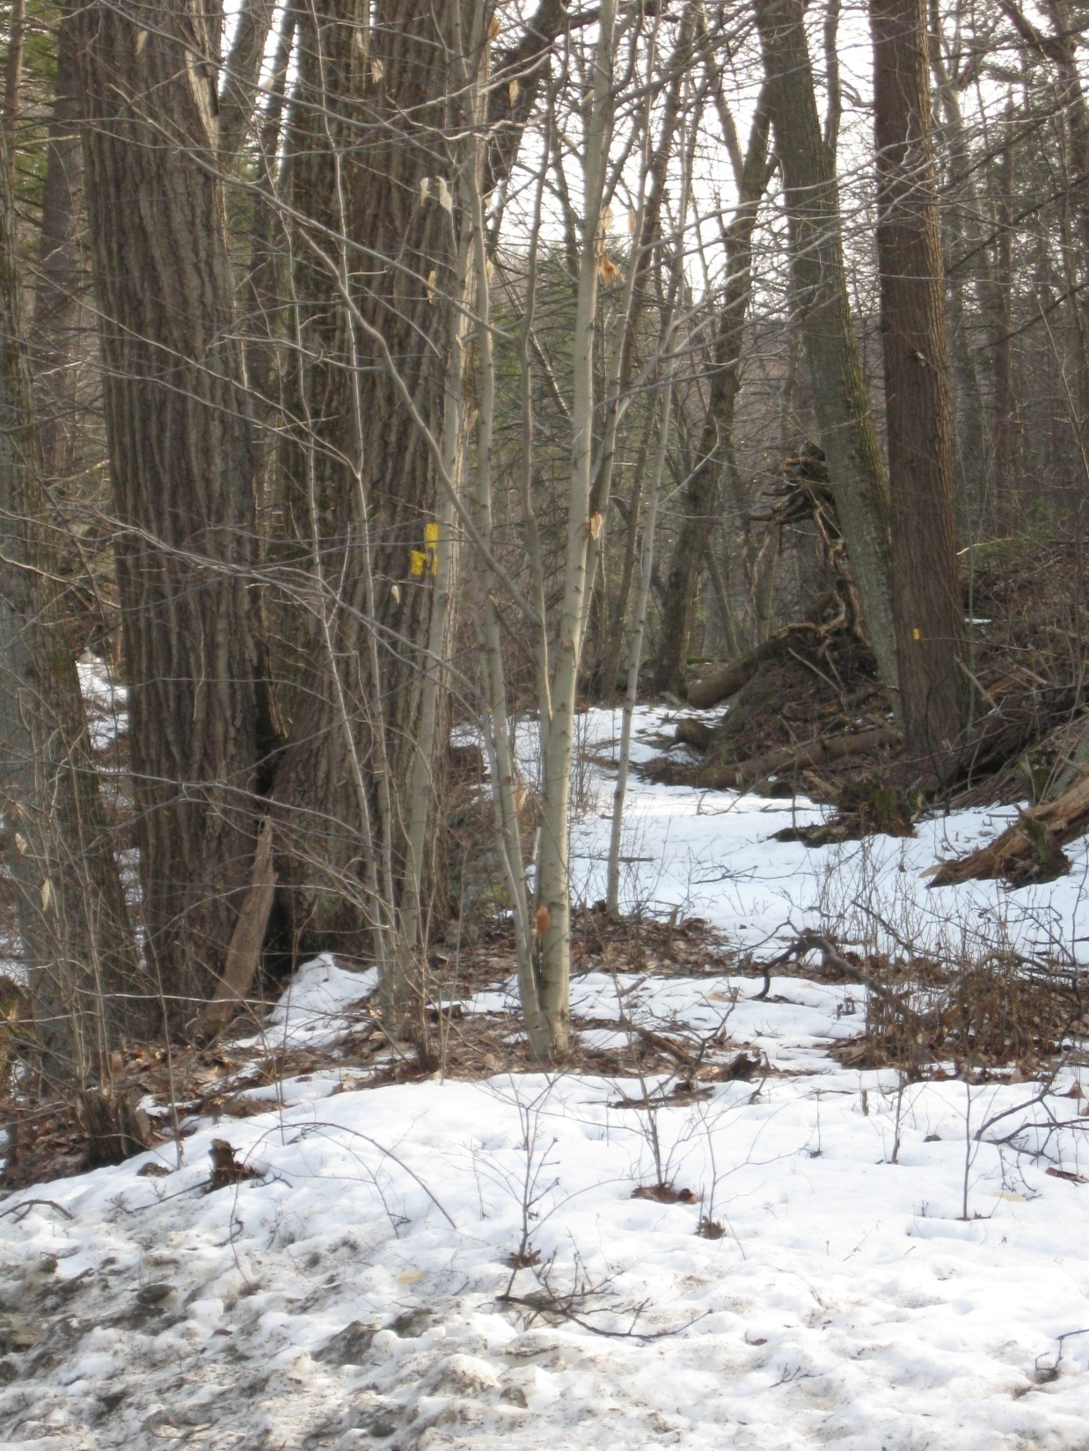
Another problem! What is it?
Notes:
Vegetation has not been completely removed
Blaze is not in a good position

Slide 41
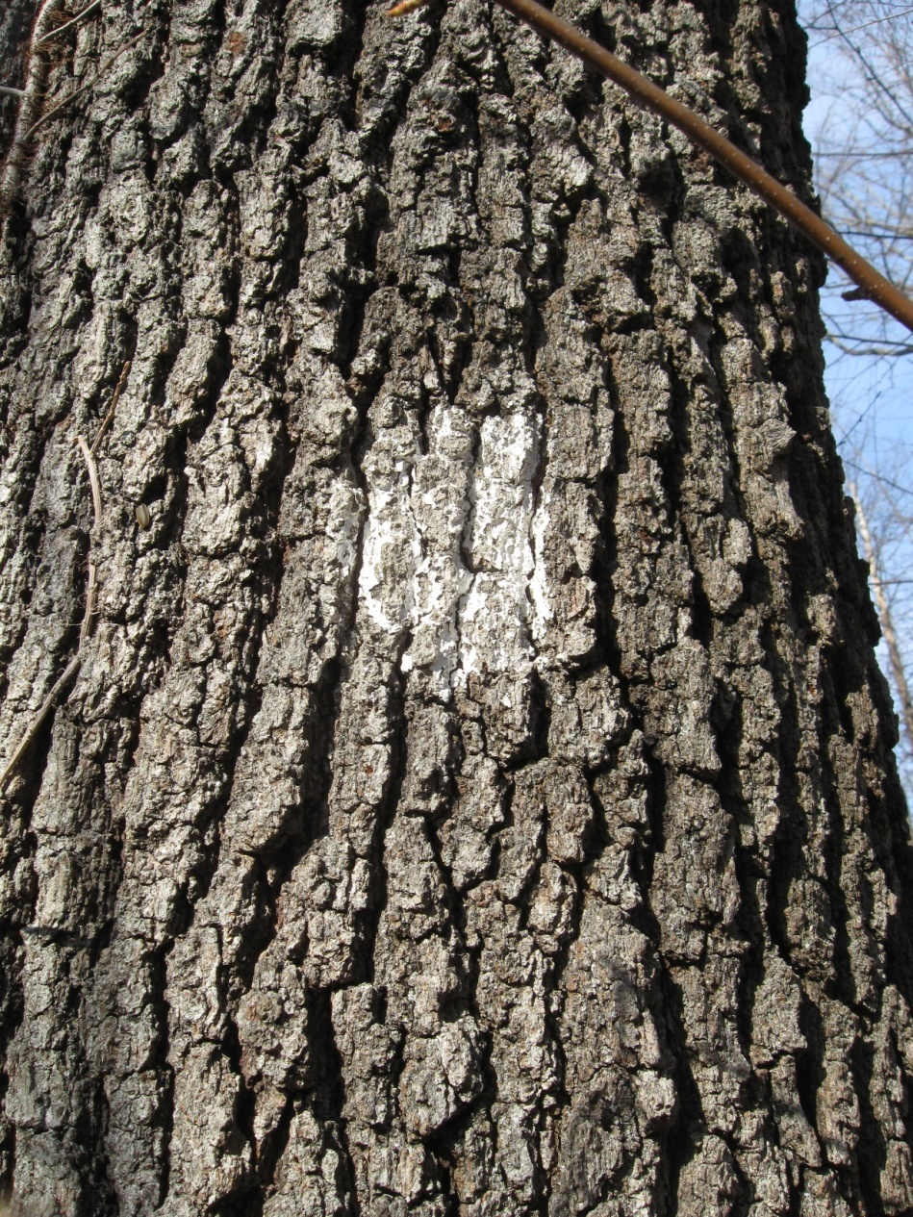
What’s wrong
Notes:
Blaze is on the wrong tree
Blaze is faded

Slide 42
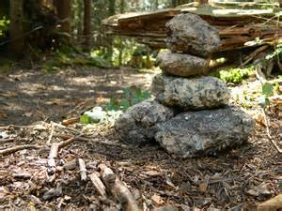
Poor choice
Good option
Notes:
Used a dead tree –
Cairn could be used instead or a live tree in the right location.

Slide 43
Invasives Strike Force www.nynjtc.org/invasives
Notes:
Relatively new initiative

Slide 44
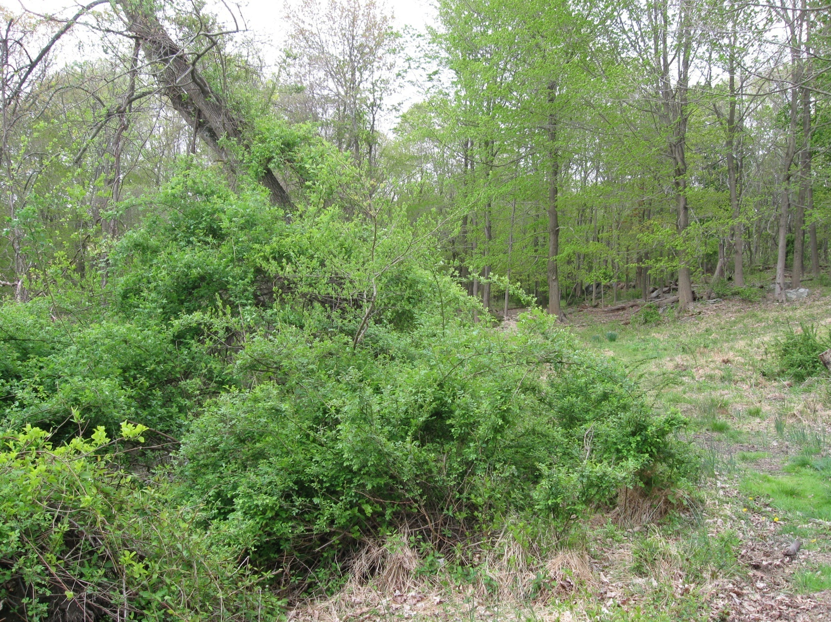
Special (and not so special) plants on your trail
Multi Flora Rose
.
Notes:
On your first trip on you will see what invasives are on your trail.
Maintainers need not be plant experts, but it’s interesting to know something about plants which grow near your trail.
If your trail has threatened and endangered species along it, your supervisor will tell you.

Slide 45
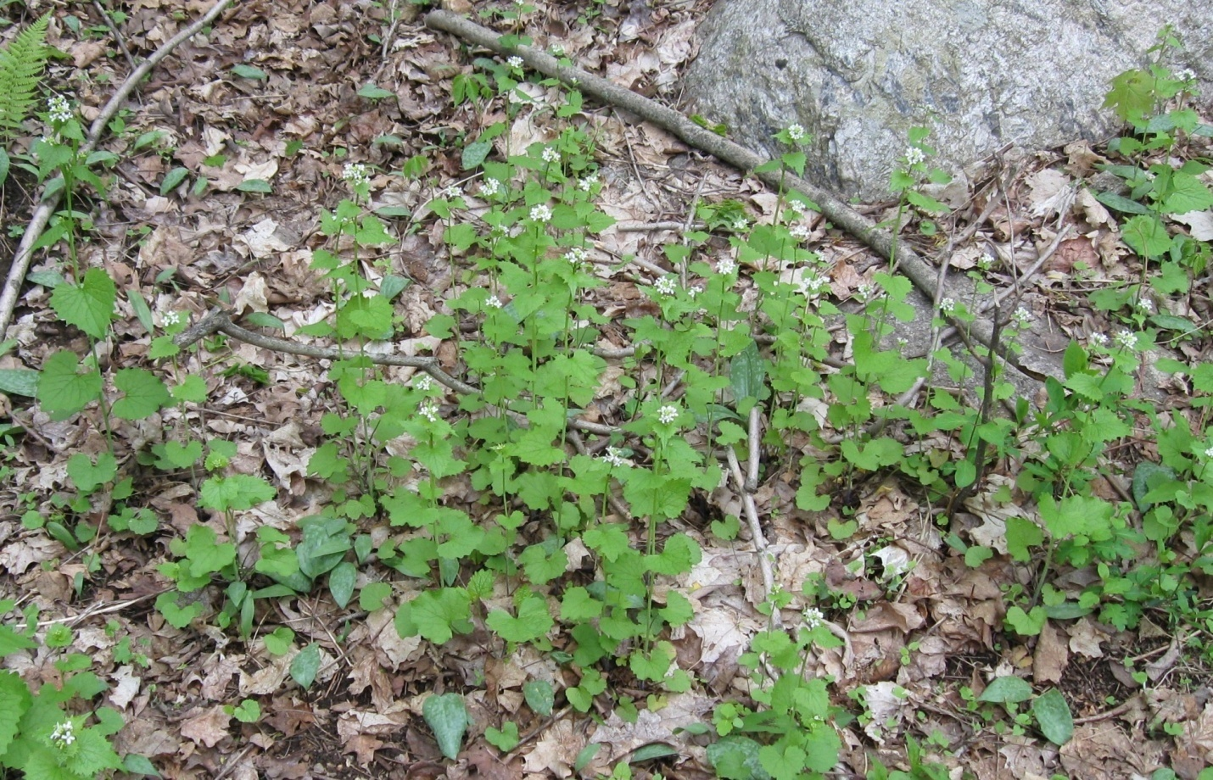
Barberry
Garlic Mustard
Notes:
Work to fight new invasions so as to make your job easier.

Slide 46
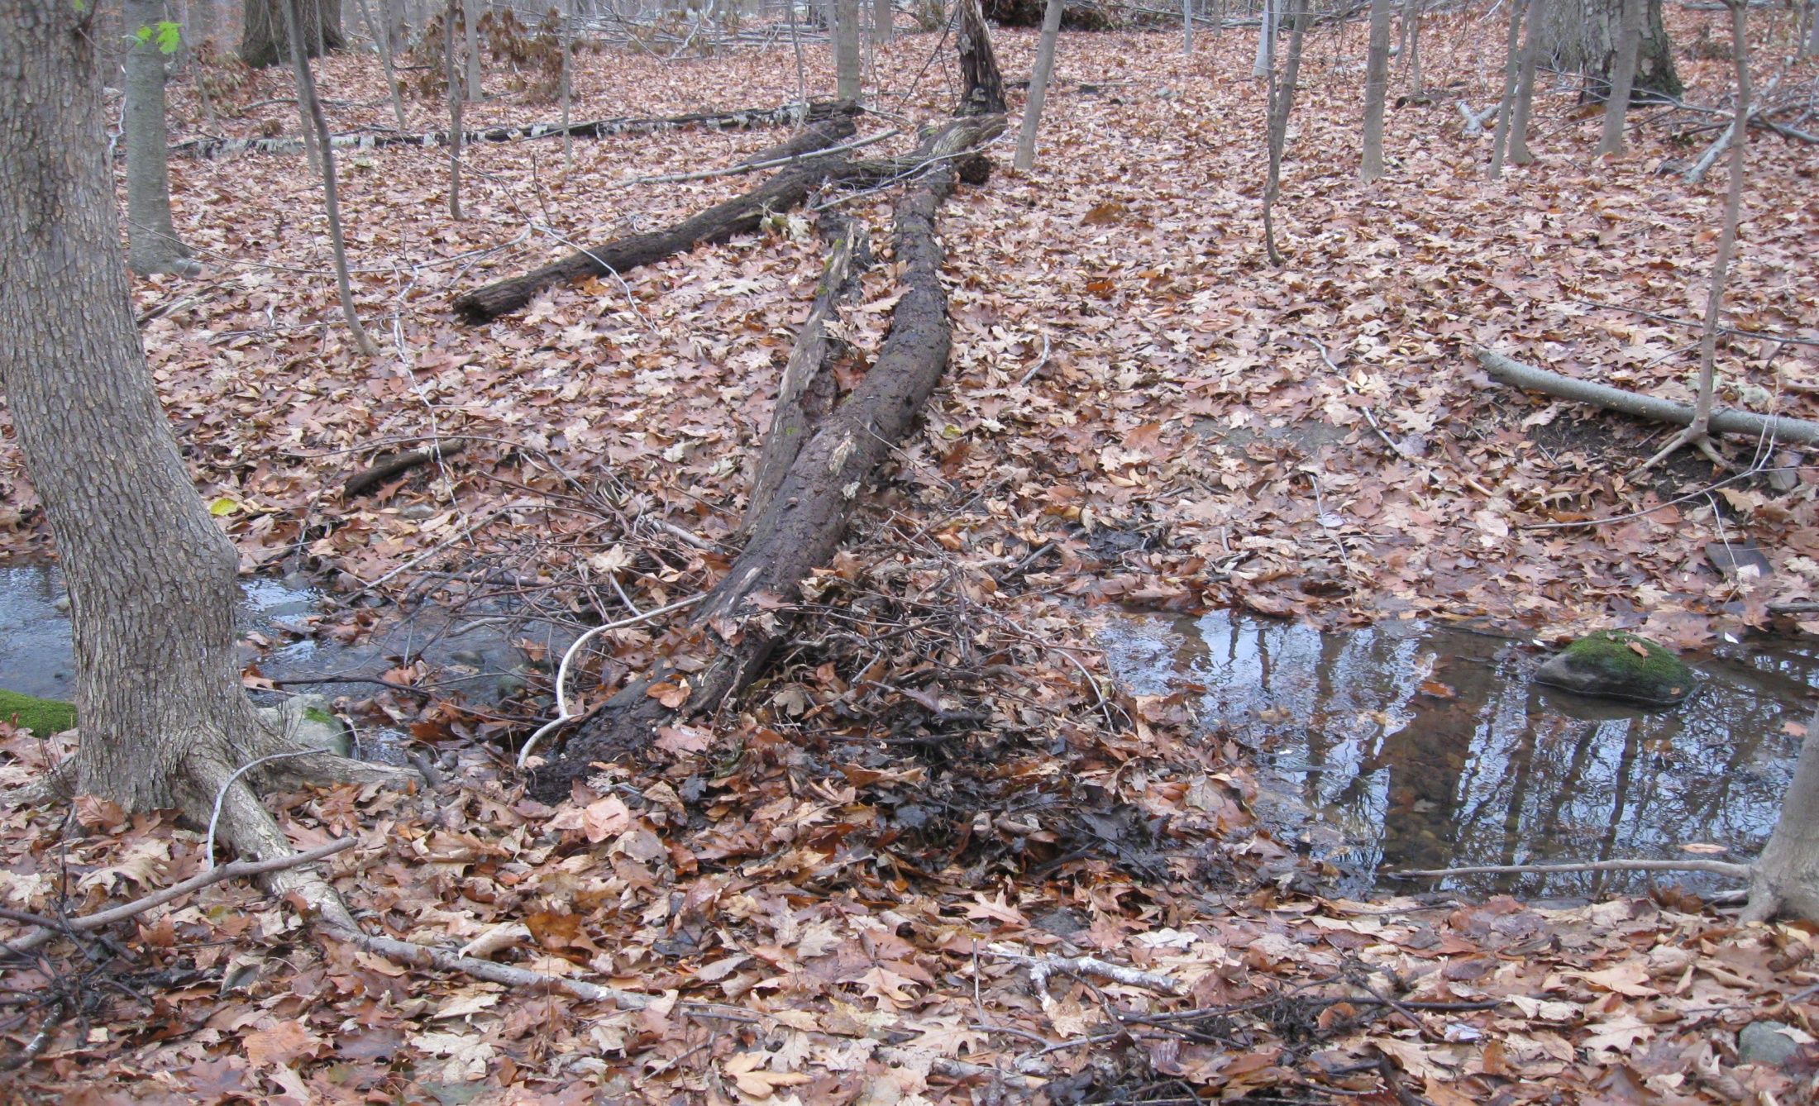
Can you spot the problem?
Notes:
Wet area

Slide 47
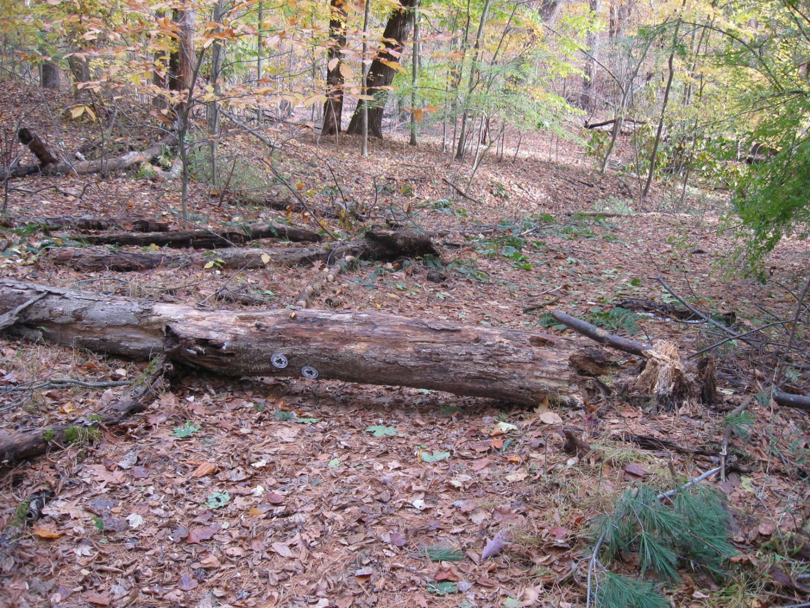
Notes:
Dead tree with blazes

Slide 48
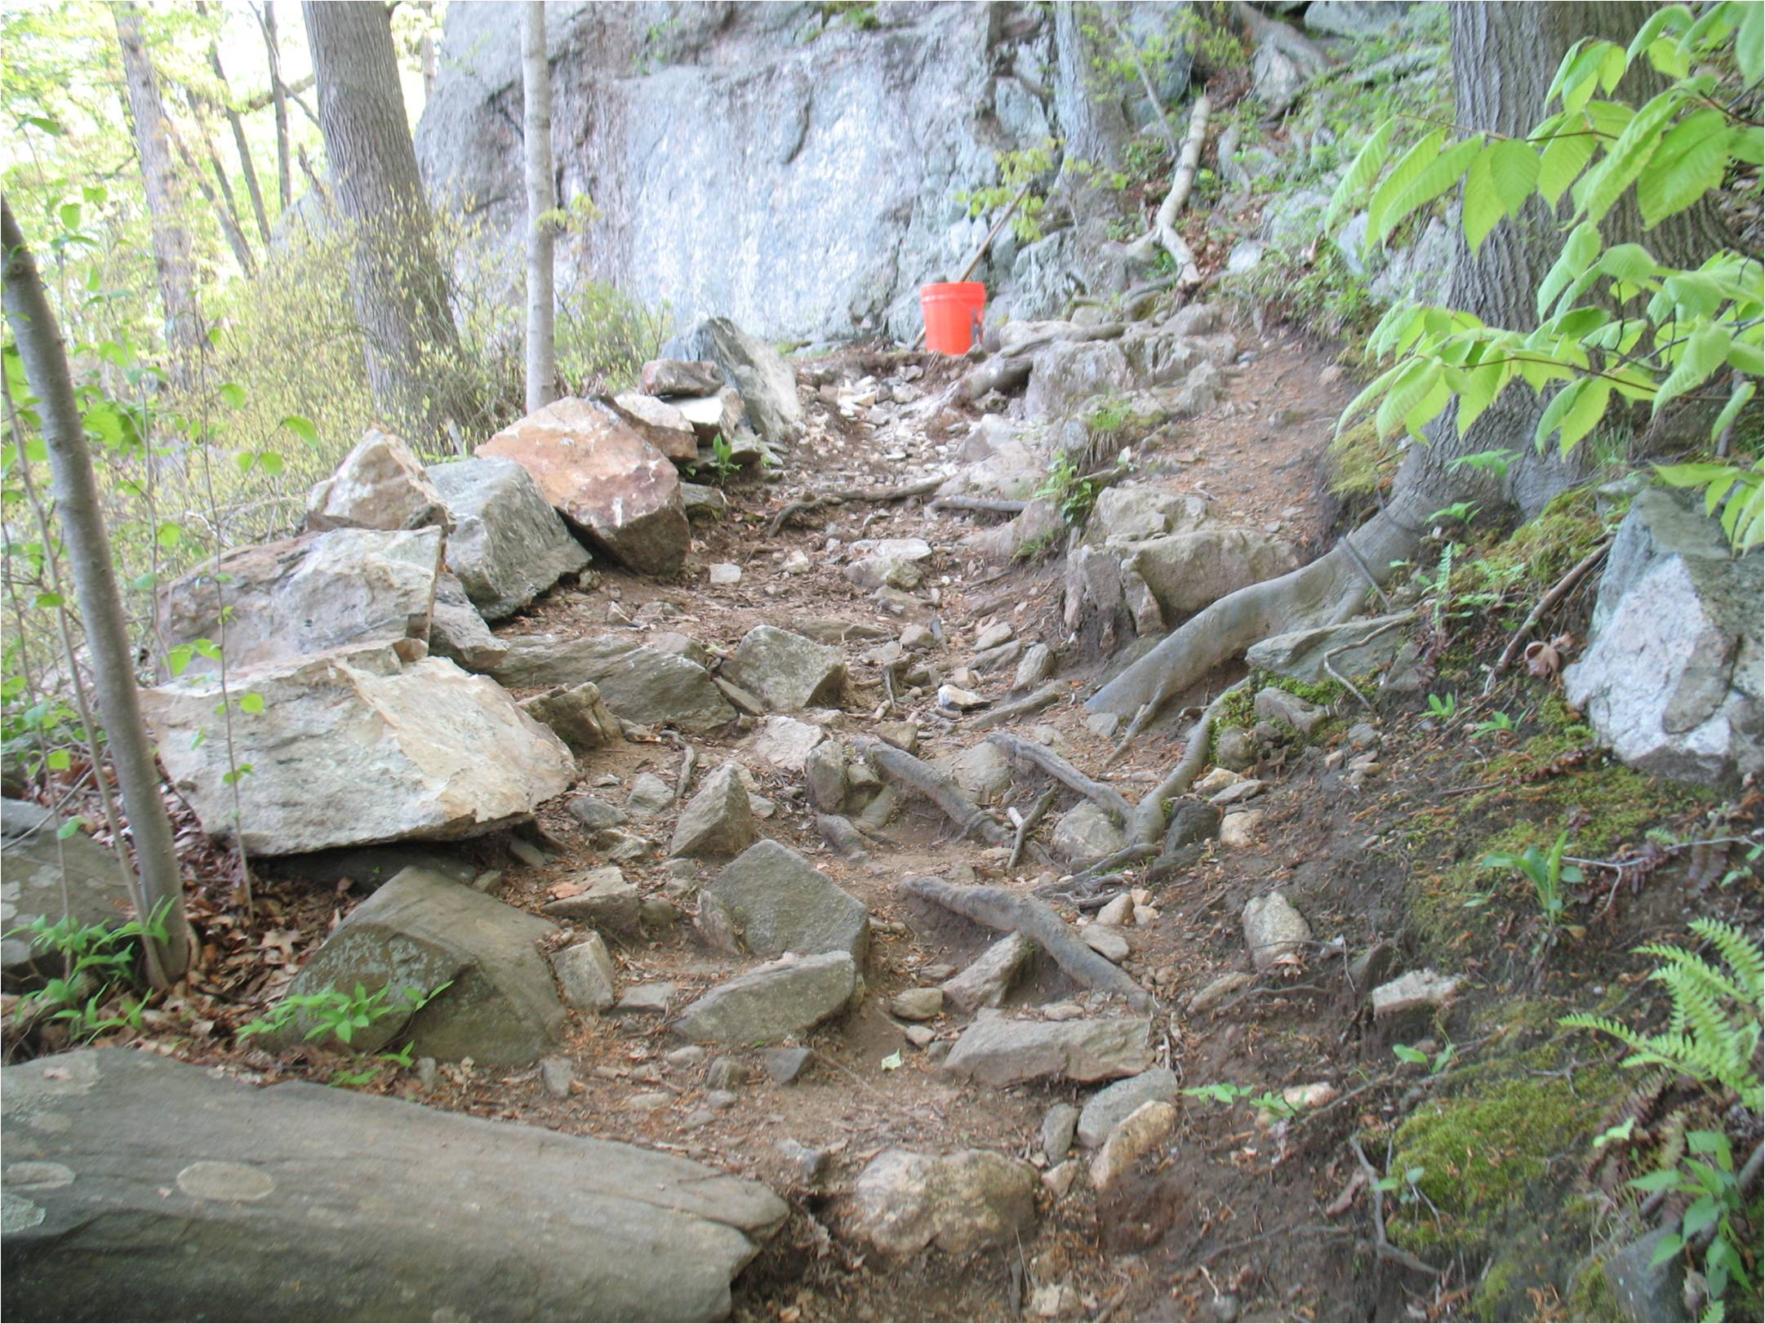
Patrolling and Reporting
Notes:
Be aware of poor trail conditions. If you don’t like it, neither will others.
Report and discuss with your Supervisor as to possible relocations of some trail sections.
What problems exist and where when you see them
If you think the trail should be relocated to avoid a problem
If you have a problem with invasives
You decide to step down as a maintainer

Slide 49
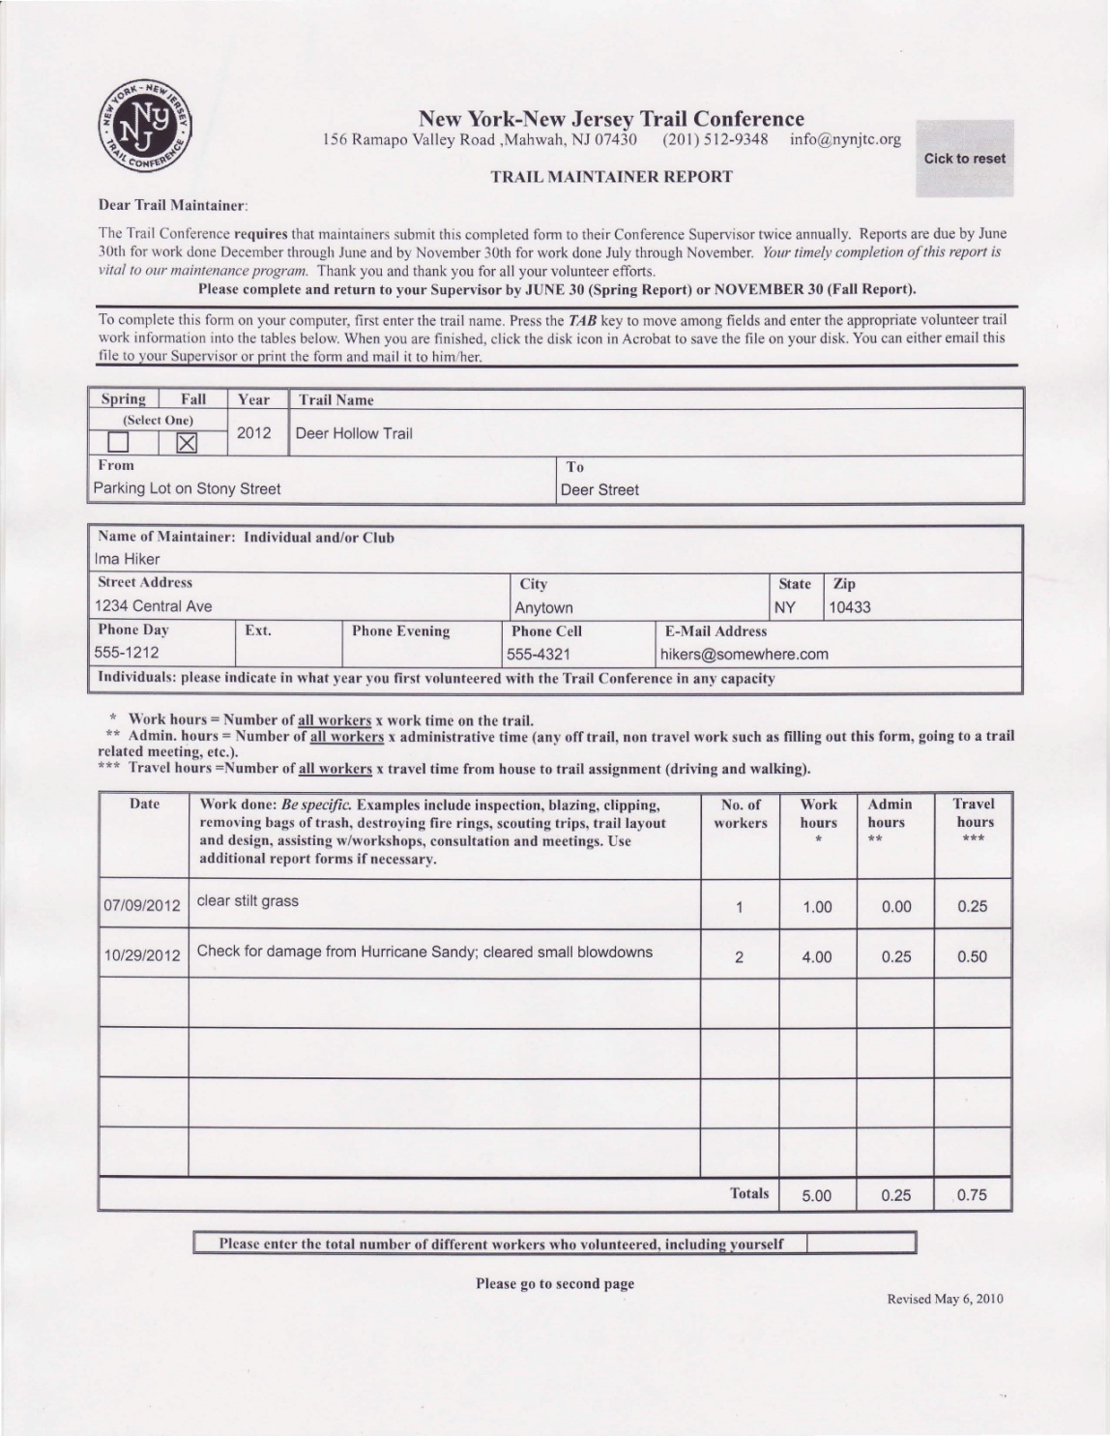
Reporting
Notes:
Ask why reporting is important.
Emphasize need for information on trail condition and needs and use for obtaining grants and other support from agencies.
Have participants fill out form of what they did that day.
Remind them to let you know about problems when they see them, not when they send the report in.

Slide 50
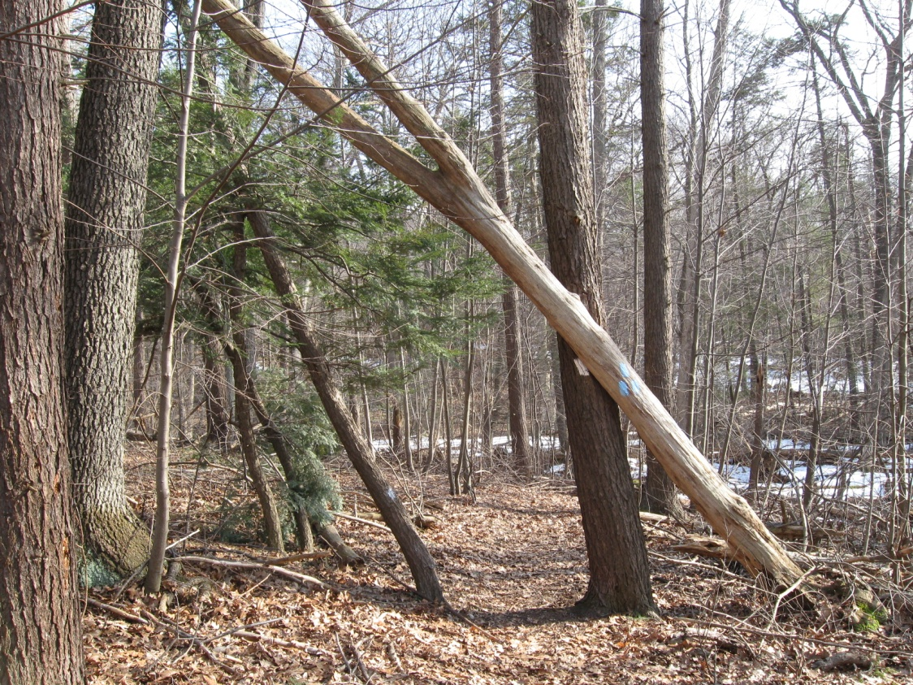
Let your supervisor know promptly
What problems exist
Where they are
When you saw them
Notes:
don’t wait until the reporting period.

Slide 51
Report blowdowns
Photos are best, along with locations
You might be asked to help
Notes:
Photos describe the situation best, for chain sawyer to know what tools to bring.

Slide 52
Do you need something replaced or built?

Slide 53
If you have a problem with invasives

Slide 54
Is there too much water?

Slide 55
Should the trail be relocated?

Slide 56
Why Move the Trail?
Align trail with terrain so that you can
Minimize erosion
Maintain the treadway
Avoid wet areas
Make trail safer
Gain improved views or interesting features
Conform to landowner requests

Slide 57
Relocations Need Approvals
Talk with your supervisor

Slide 58
Maintenance Cycle
Clean up winter and spring storm damage
Notify supervisor of problems
Plan work
Clip after spring and early summer growth
Blazing
File spring report with supervisor
Spring
Summer
Winter
Fall
File fall report with supervisor
Check trail (if conditions permit)
Check trail
Clean up
Clean drainages
Complete projects
Notes:
Review what we have done in class;

Slide 59
Volunteers can move mountains! Join the fun!
Notes:
Happy Workers.
Have sign-up sheets and upcoming crews or training schedules available

Slide 60
Steps to Become a Maintainer
Notes:
Just as important - if you want to stop being a maintainer

Slide 61
It was great to have
you at the workshop
Thanks for attending!
Notes:
Have participants complete course evaluations and have them fill out Volunteer Interest forms – for region of interest.
Have a large envelope for evaluations

