Slide 1
East Hudson Regional Trail Council
August 10, 2015
Notes:
Manages and maintains hiking trails in NY metro region
Publishes maps and books
Advocates for protection of trail and trail lands

Slide 2
Agenda
Welcome and Introductions
Presentation of RTC and Policy Council
The election of an RTC chair to serve through the end of 2016
Discussion of annual planning process
Brief updates/reports from each local trail committee
Review/approval of new trails and major relocations
Discussion of problems, projects and opportunities for regional collaboration
Adjournment

Slide 3
Regional Trail Council and Policy Council
Presentation of organizational restructuring

Slide 4
Timeline
In summer of 2014 the Board of Directors identified the need to update and improve the organization’s structure and decision making practices.
A third party facilitator was engaged to oversee and assist the process.
Notes:
Representative of Trail Conference

Slide 5
Steering Committee Composition
Equal numbers of Board, Staff, and Volunteers
Trail Chairs from diverse regions
Trails Council Chair
Volunteers from non-trail committees
Board Chair and Vice-chair
Chair of Strategic Planning
Trail Supervisors
Notes:
Representative of Trail Conference

Slide 6
Established Key Considerations
Trail Committee structure is working well
Board is legally responsible to act in public interest
Establish local control desirable to lowest level practicable
Need strong working relationships within framework of accountability

Slide 7
The Process
In October 2014 a Summit of 59 leaders identified attributes of success within the Trail Conference.
After 5-months of collaboration, the Steering Committee presented a proposal to 63 organizational leaders at a second Summit for comments and feedback.
In May 2015 the Steering Committee presented the Board of Directors with a final recommendation.
Notes:
What makes things work well

Slide 8
Feedback from October Summit
Planning with clear objectives and outcomes
Clear decision-making structure with good coordination and follow-through
Clear roles among board, volunteers and staff
Mutually supportive relationships
Fully empowered groups
Clear lines of communication
Good support for volunteers
Consistent policies and procedures
Notes:
What makes things work well

Slide 9
The Proposal
Accountability, Delegation and Assessment
Restructuring of current Trails Council by establishing two entities
Regional Trails Councils (RTC)
Policy Council
Annual Plan Development
Implementation of Policies and Annual Plan
Notes:
What makes things work well

Slide 10
Accountability, Delegation and Assessment
The Board is responsible to Trail Conference Voting Members (delegates)
The Board has the authority to hold the Board Chair, Exec, and Policy Council accountable
The Board delegates authority to the Exec to hold program staff and RTC, LTC and Program Area Chairs accountable
The Exec delegates authority to LTC Chairs to hold Trail Supervisors and Crew Chiefs accountable
Notes:
What makes things work well

Slide 11
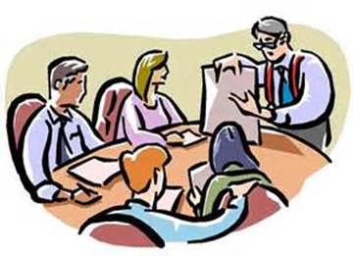
Regional Trail Councils (RTC)
Benefits
Scope
Composition
Procedure

Slide 12
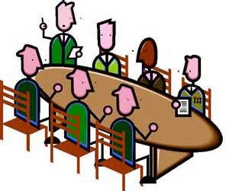
Policy Council
Scope
Composition
Process
Procedures
Notes:
ATC’s Stewardship Council - model they have used since 2005
Committees organized around strategic plan issues or priority set by board.
Can address both policy and practice
All policies except for governance ones (nominating, succession, nepotism… )

Slide 13
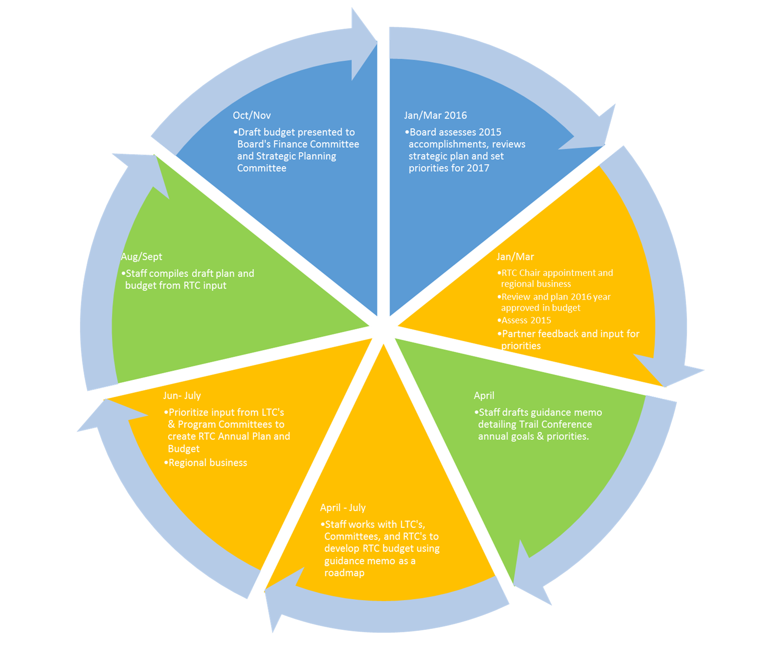

Slide 14
Successful Implementation
Planning and Setting Priorities
Setting Clear Lines of Authority and Accountability
Collaborating and Building Capacity
Success
Notes:
We need to plan together
= two sides of the coin
Command and control doesn’t work here

Slide 15
Mode of Operation
Acknowledged existence of many different opinions
Established ground rules including:
Be respectful
Have positive attitude
Listen carefully to understand and not refute
Be persuasive and persuadable
Work towards consensus – a decision each can live with and support

Slide 16
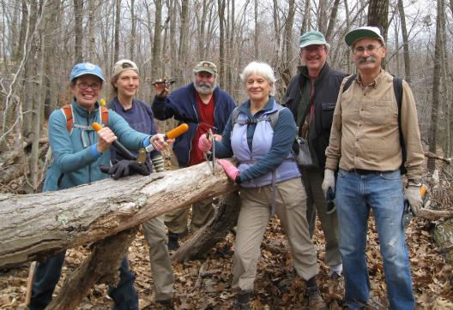
Our best work gets done when we
Ask what might be needed
Have meetings with focused agendas
Work between meetings
Have fun!

